Slide 1
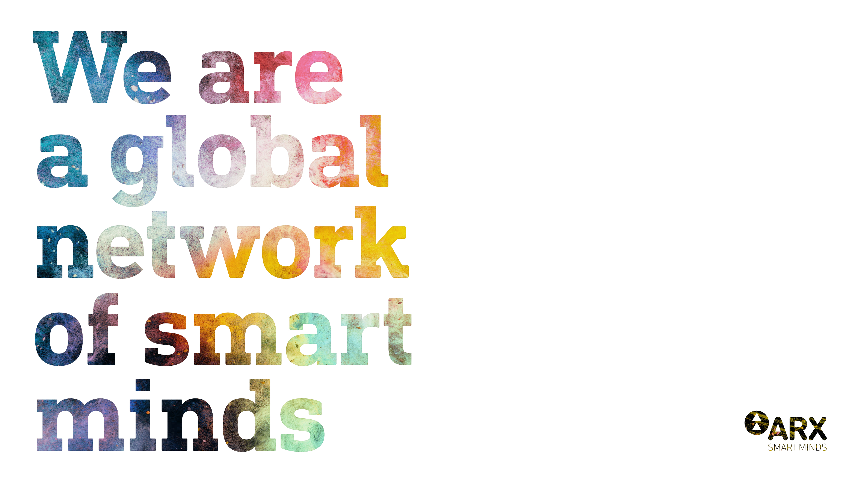

Slide 2

Providing
cutting-edge solutions
in complex design
and engineering

Slide 3
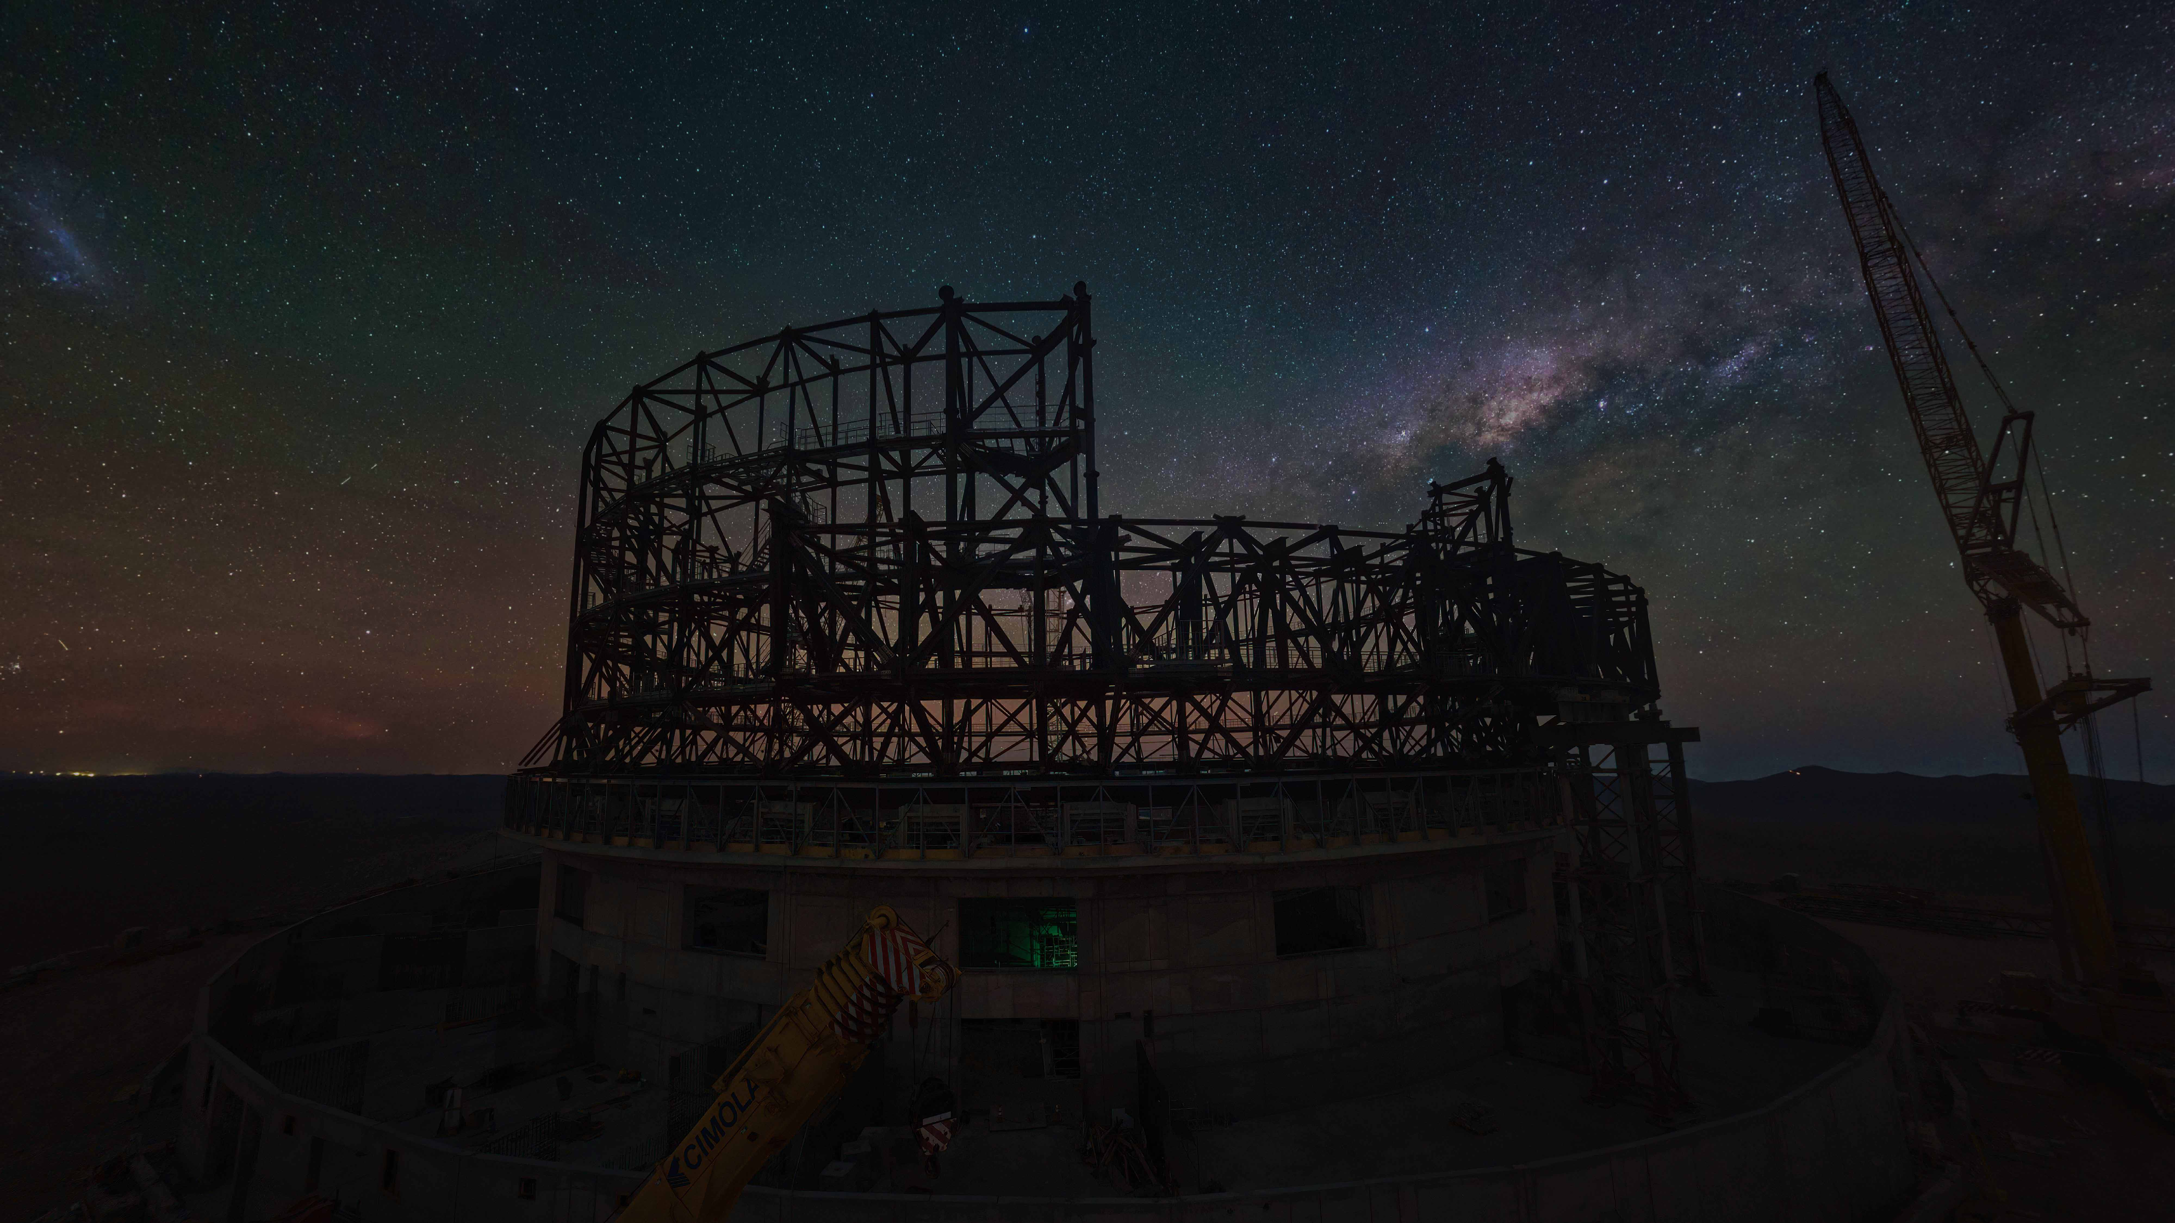
Our vibrant community is embarking on a new journey.
We have combined diverse companies, empowering individuals with
our collective strength, placing the future firmly in their hands.
This agile task force operates on a global scale with thousands of
colleagues worldwide. Drawing on our deep-rooted commitment
to innovation, ARX is reaching higher, devising sustainable
solutions that pave the way for a bright future.
We are transforming communities one at a time, remaining
focused on our mission:

Slide 4
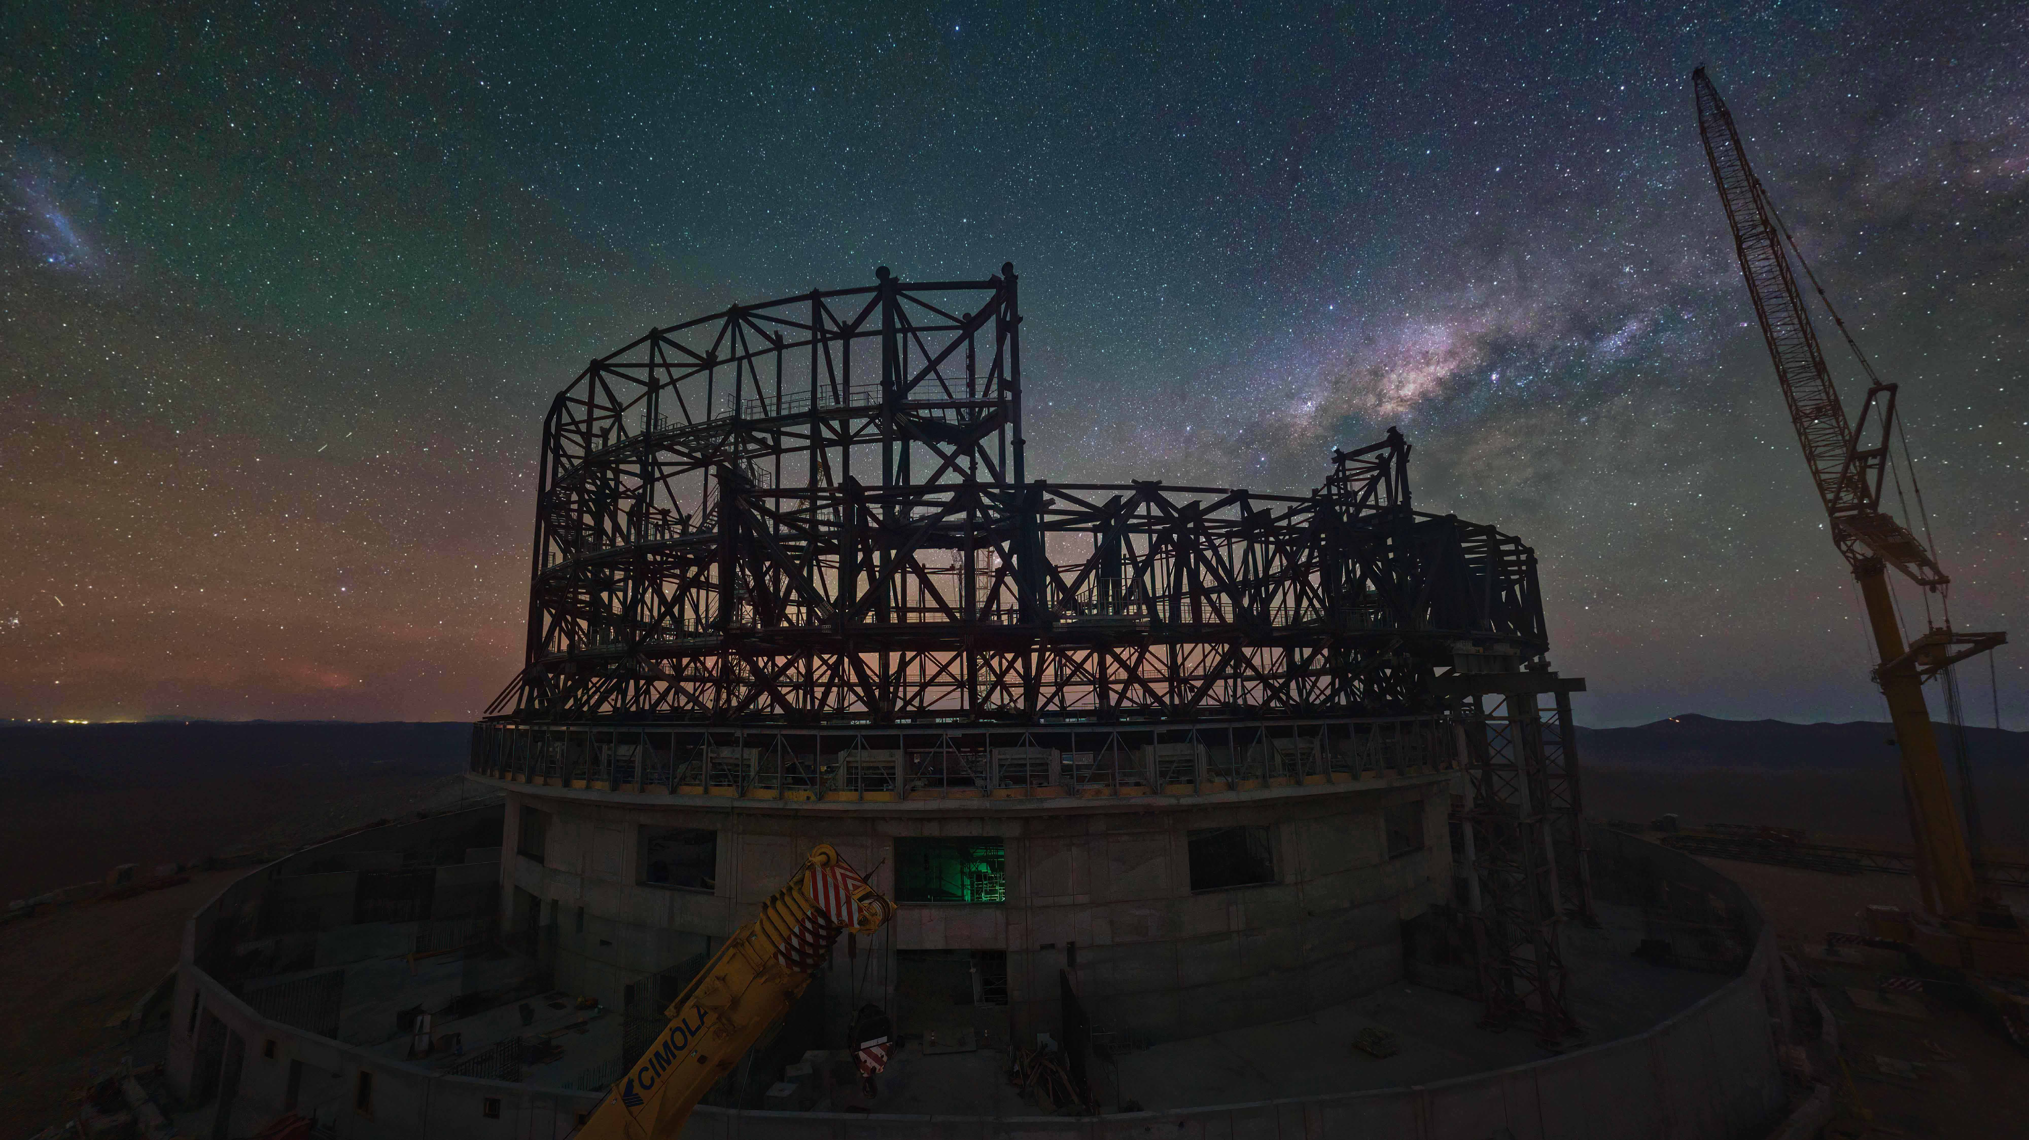
Our vibrant community is embarking on a new journey.
We have combined diverse companies, empowering individuals with
our collective strength, placing the future firmly in their hands.
This agile task force operates on a global scale with thousands of
colleagues worldwide. Drawing on our deep-rooted commitment
to innovation, ARX is reaching higher, devising sustainable
solutions that pave the way for a bright future.
We are transforming communities one at a time, remaining
focused on our mission:
Make it happen

Slide 5
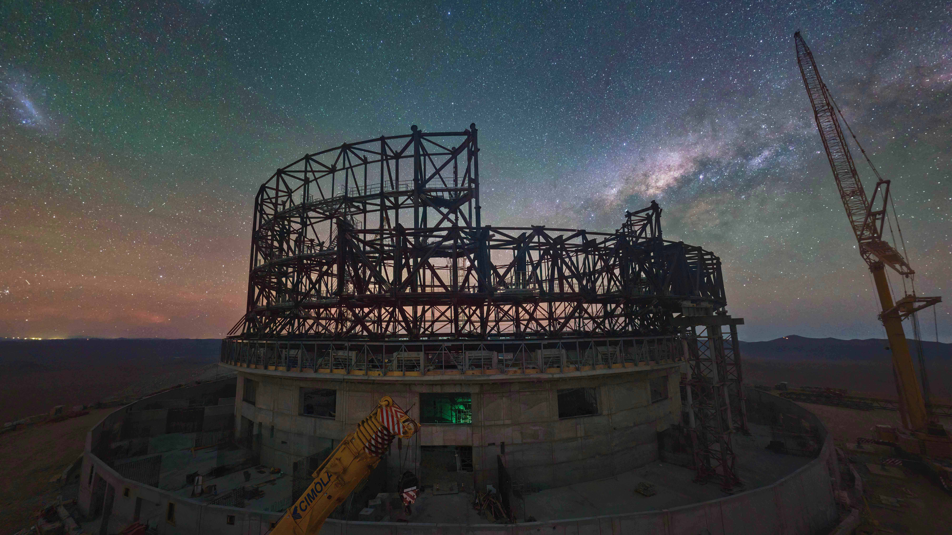
Our vibrant community is embarking on a new journey.
We have combined diverse companies, empowering individuals with
our collective strength, placing the future firmly in their hands.
This agile task force operates on a global scale with thousands of
colleagues worldwide. Drawing on our deep-rooted commitment
to innovation, ARX is reaching higher, devising sustainable
solutions that pave the way for a bright future.
We are transforming communities one at a time, remaining
focused on our mission:
Make it happen

Slide 6
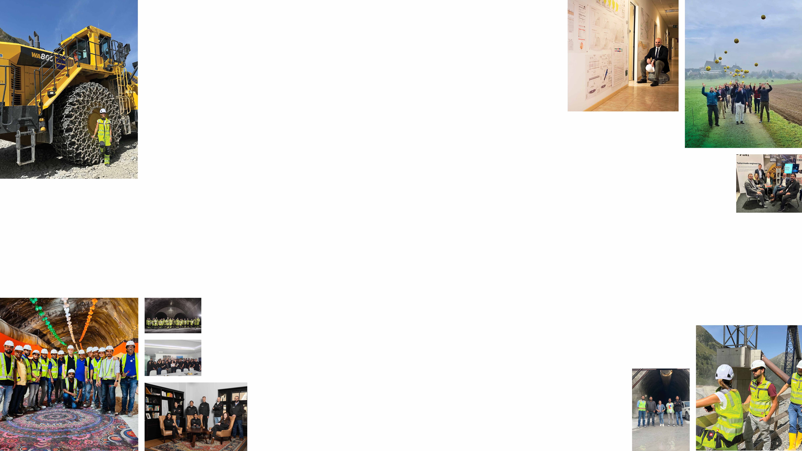
Our multidisciplinary teams
are made of

Slide 7
Our multidisciplinary teams
are made of
People
We are a comprehensive network of specialists,
always integrating talent and expertise.
Tackling complex design projects, ARX adapts and evolves
with the dynamic and challenging global landscape.
Continual evolution leads to continual growth.

Slide 8
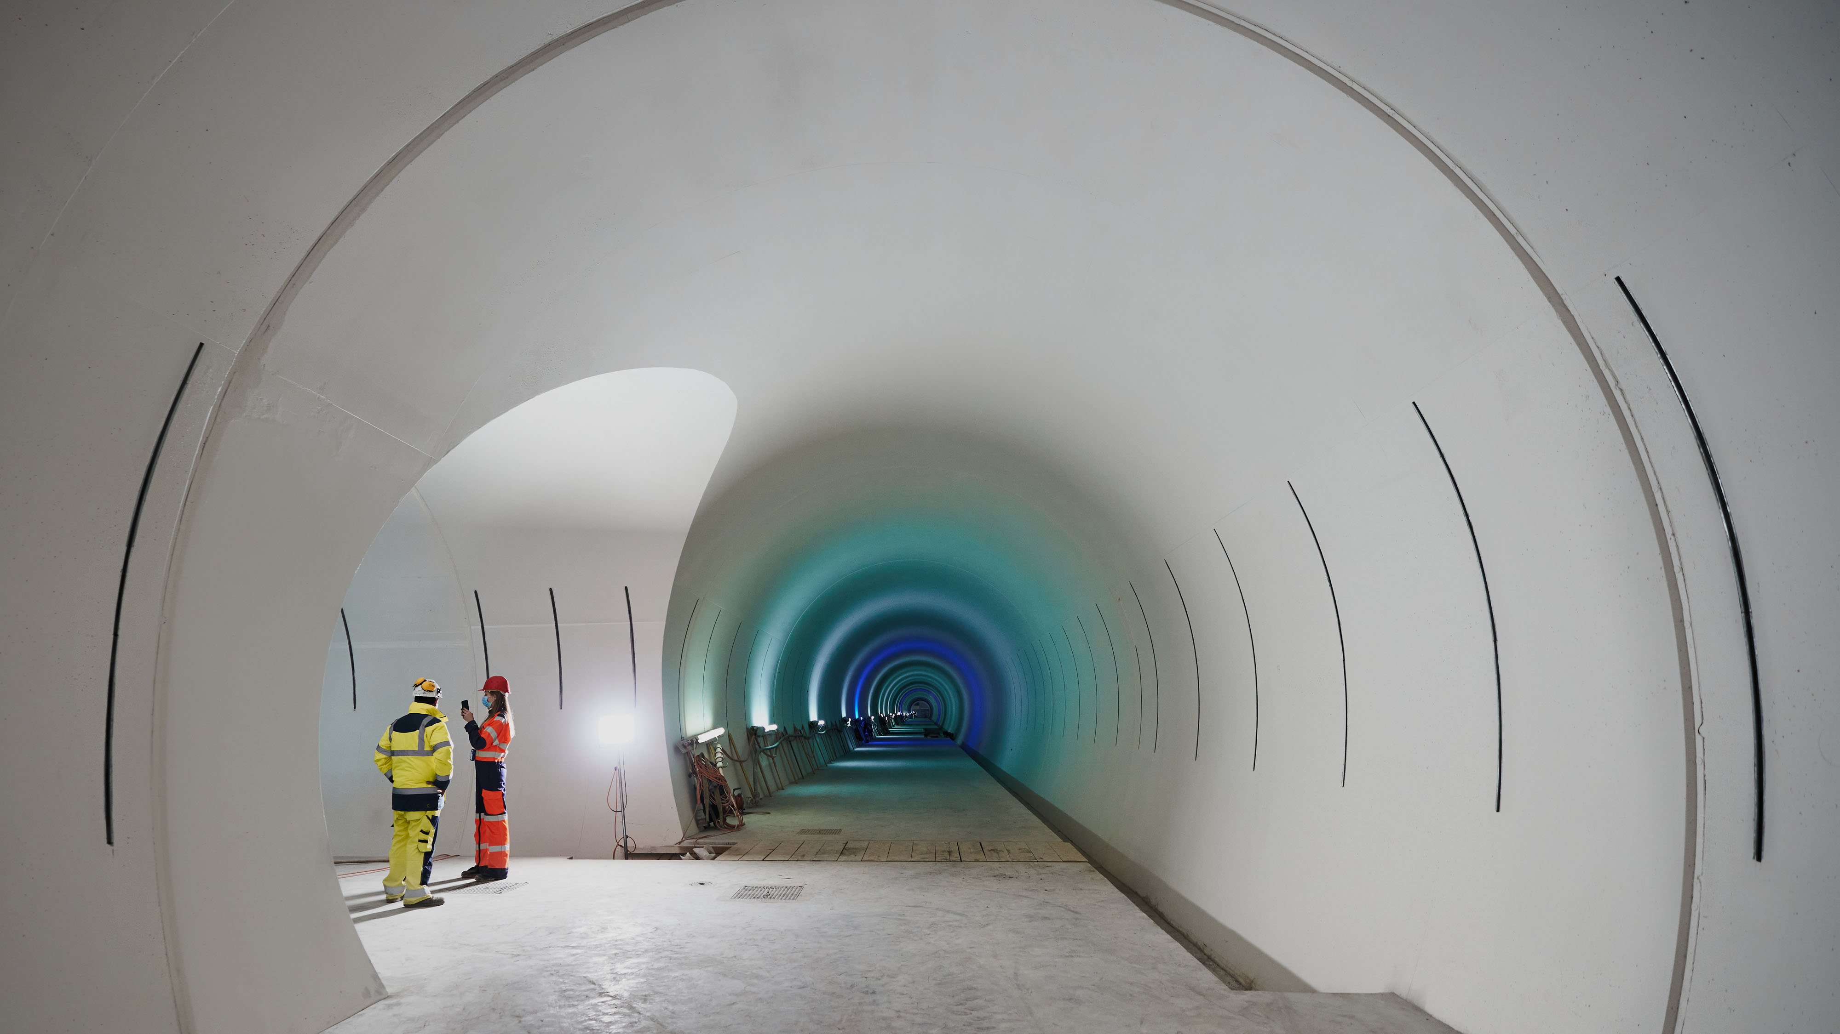
We are experts in selected design disciplines;
our team dives deep into technical niches while overseeing broad,
multidisciplinary projects. This versatility allows us
to confront any challenge – from the precise to the expansive –
with confidence.
Experts

Slide 9
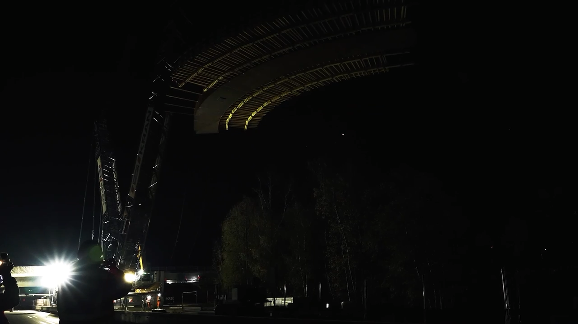
75
200
Projects in
countries
and
bridges
With well over
150
airports
in excess of
3’000
completed buildings
unlimited
and
ideas
4’000
5’000
including
km of railways
and metro
with
km of tunnels
a boost of
25’000
airports

Slide 10
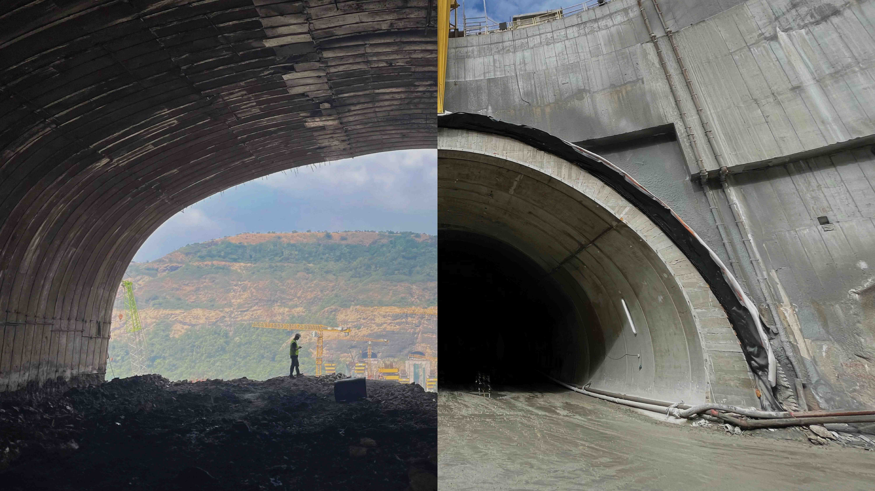
Glocal
Our
approach is central
to everything we do
Our branches act as entrepreneurial units,
developing their own networks and relationships.
This strengthens the entire group.
They develop local know-how and combine
it with global best practices,offering
a full-service package to our clients.

Slide 11
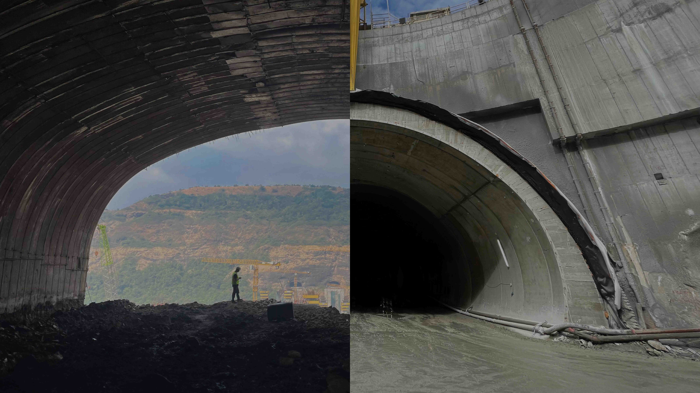
Glocal
Our
approach is central
to everything we do
Our branches act as entrepreneurial units,
developing their own networks and relationships.
This strengthens the entire group.
They develop local know-how and combine
it with global best practices,offering
a full-service package to our clients.
We are actively present in:
Albania
Argentina
Australia
Austria
Bolivia
Brazil
Chile
Denmark
Egypt
Ecuador
France
Germany
India
Israel
Italy
Nepal
Norway
Perù
Portugal
Saudi Arabia
Switzerland
Tunisia
Türkiye
United Arab Emirates
USA

Slide 12
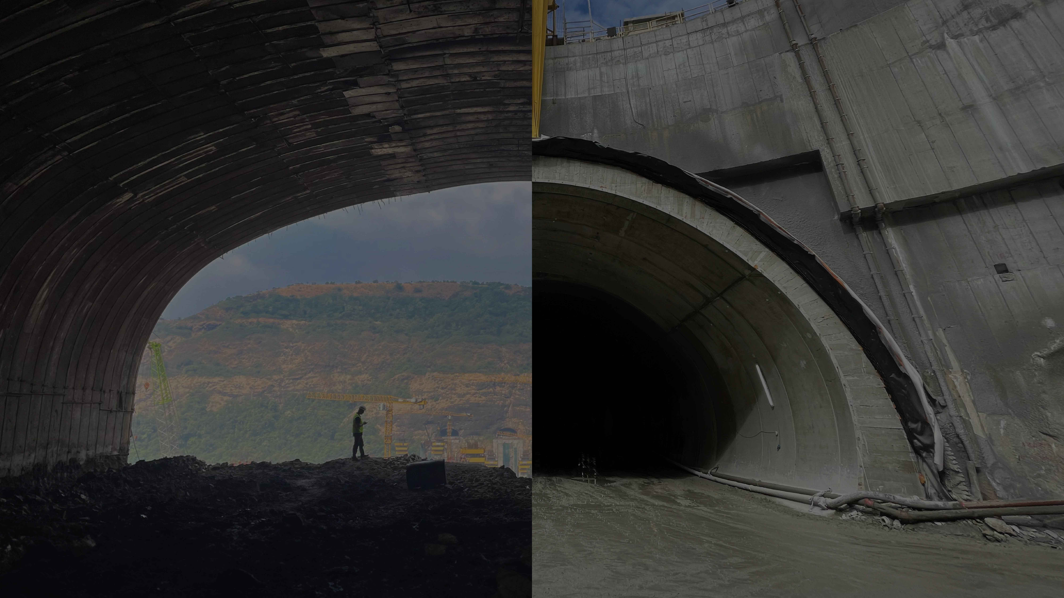
Our branches act as entrepreneurial units,
developing their own networks and relationships.
This strengthens the entire group.
They develop local know-how and combine
it with global best practices,offering
a full-service package to our clients.
We are actively present in:
Albania
Argentina
Australia
Austria
Bolivia
Brazil
Chile
Denmark
Egypt
Ecuador
France
Germany
India
Israel
Italy
Nepal
Norway
Perù
Portugal
Saudi Arabia
Switzerland
Tunisia
Türkiye
United Arab Emirates
USA

Slide 13
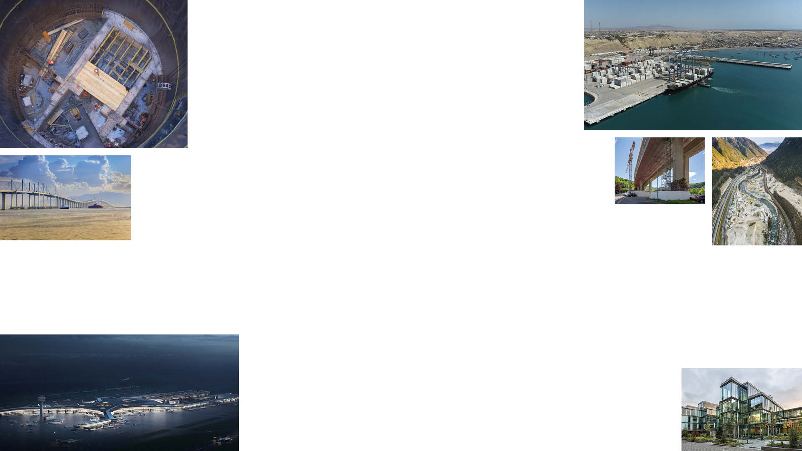
Throughout the lifecycle
of a project

Slide 14
Throughout the lifecycle
of a project
360°
Due to our size and depth of skill, ARX performs highly
in every modern engineering discipline.
From the A of Australia to the Z of Zurich, we provide
what clients, localities, and countries need most.

Slide 15
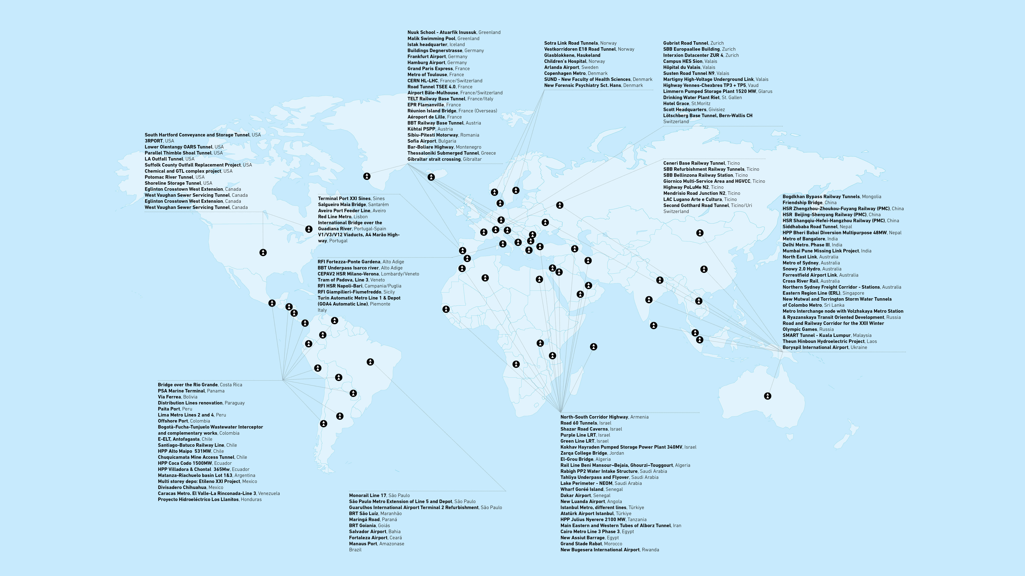
Iconic projects
around the world

Slide 16
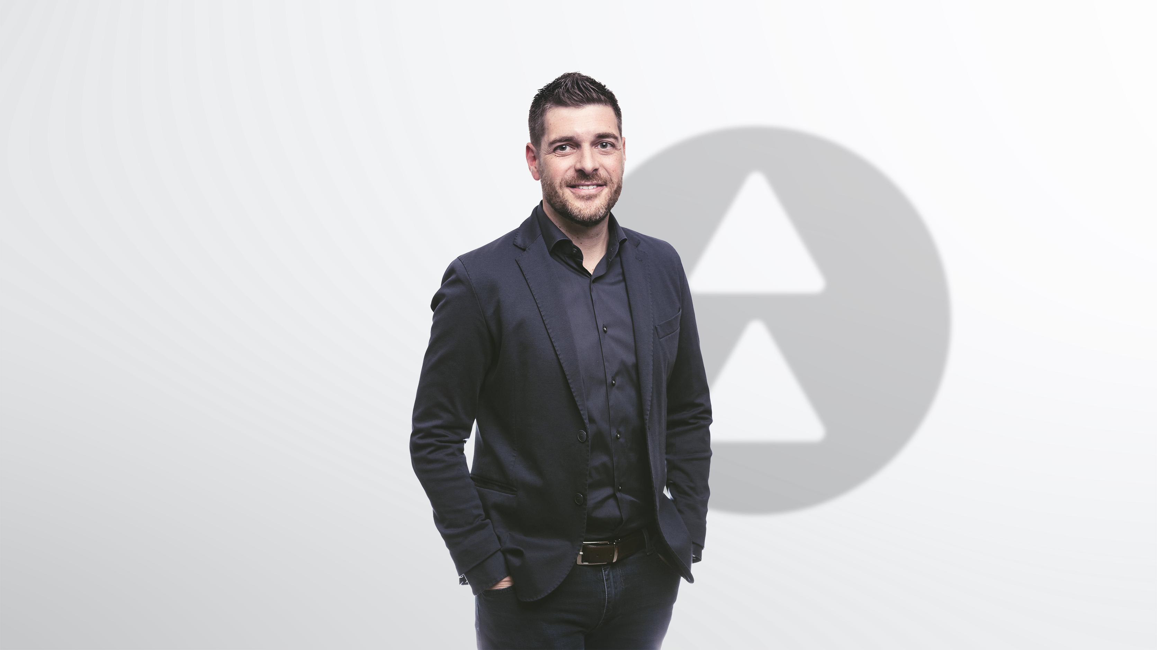
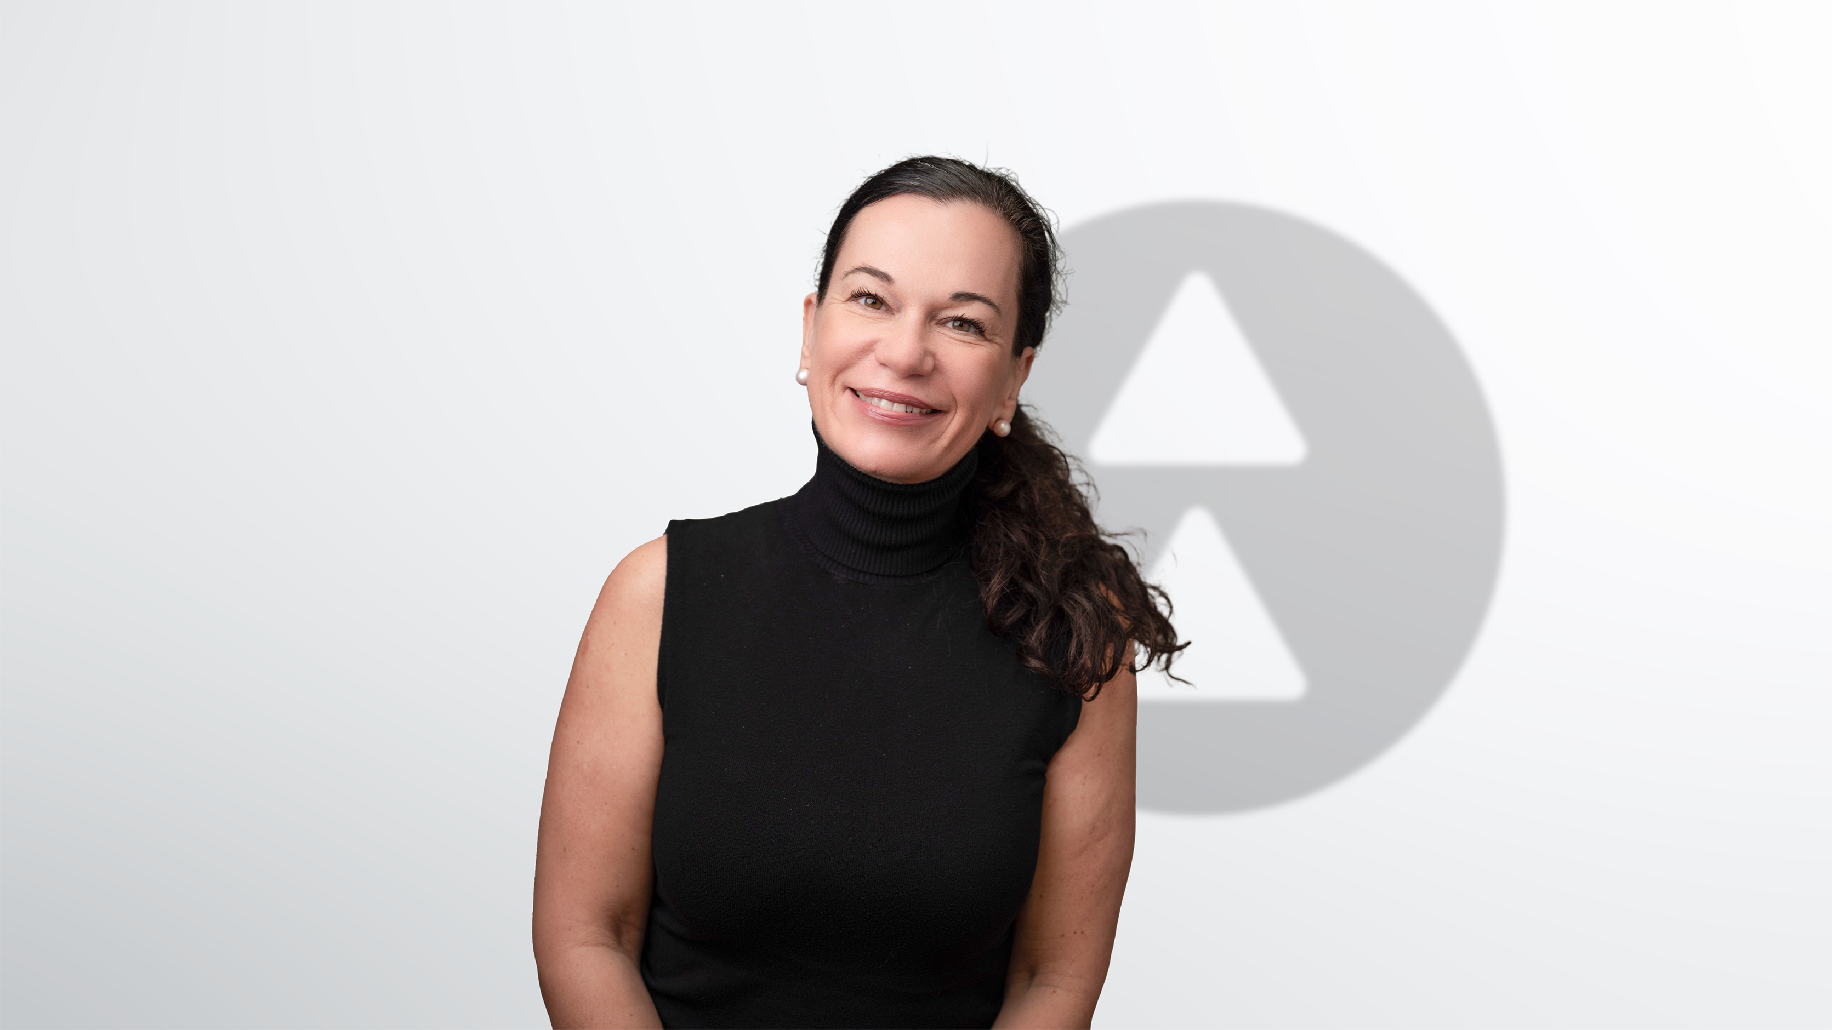
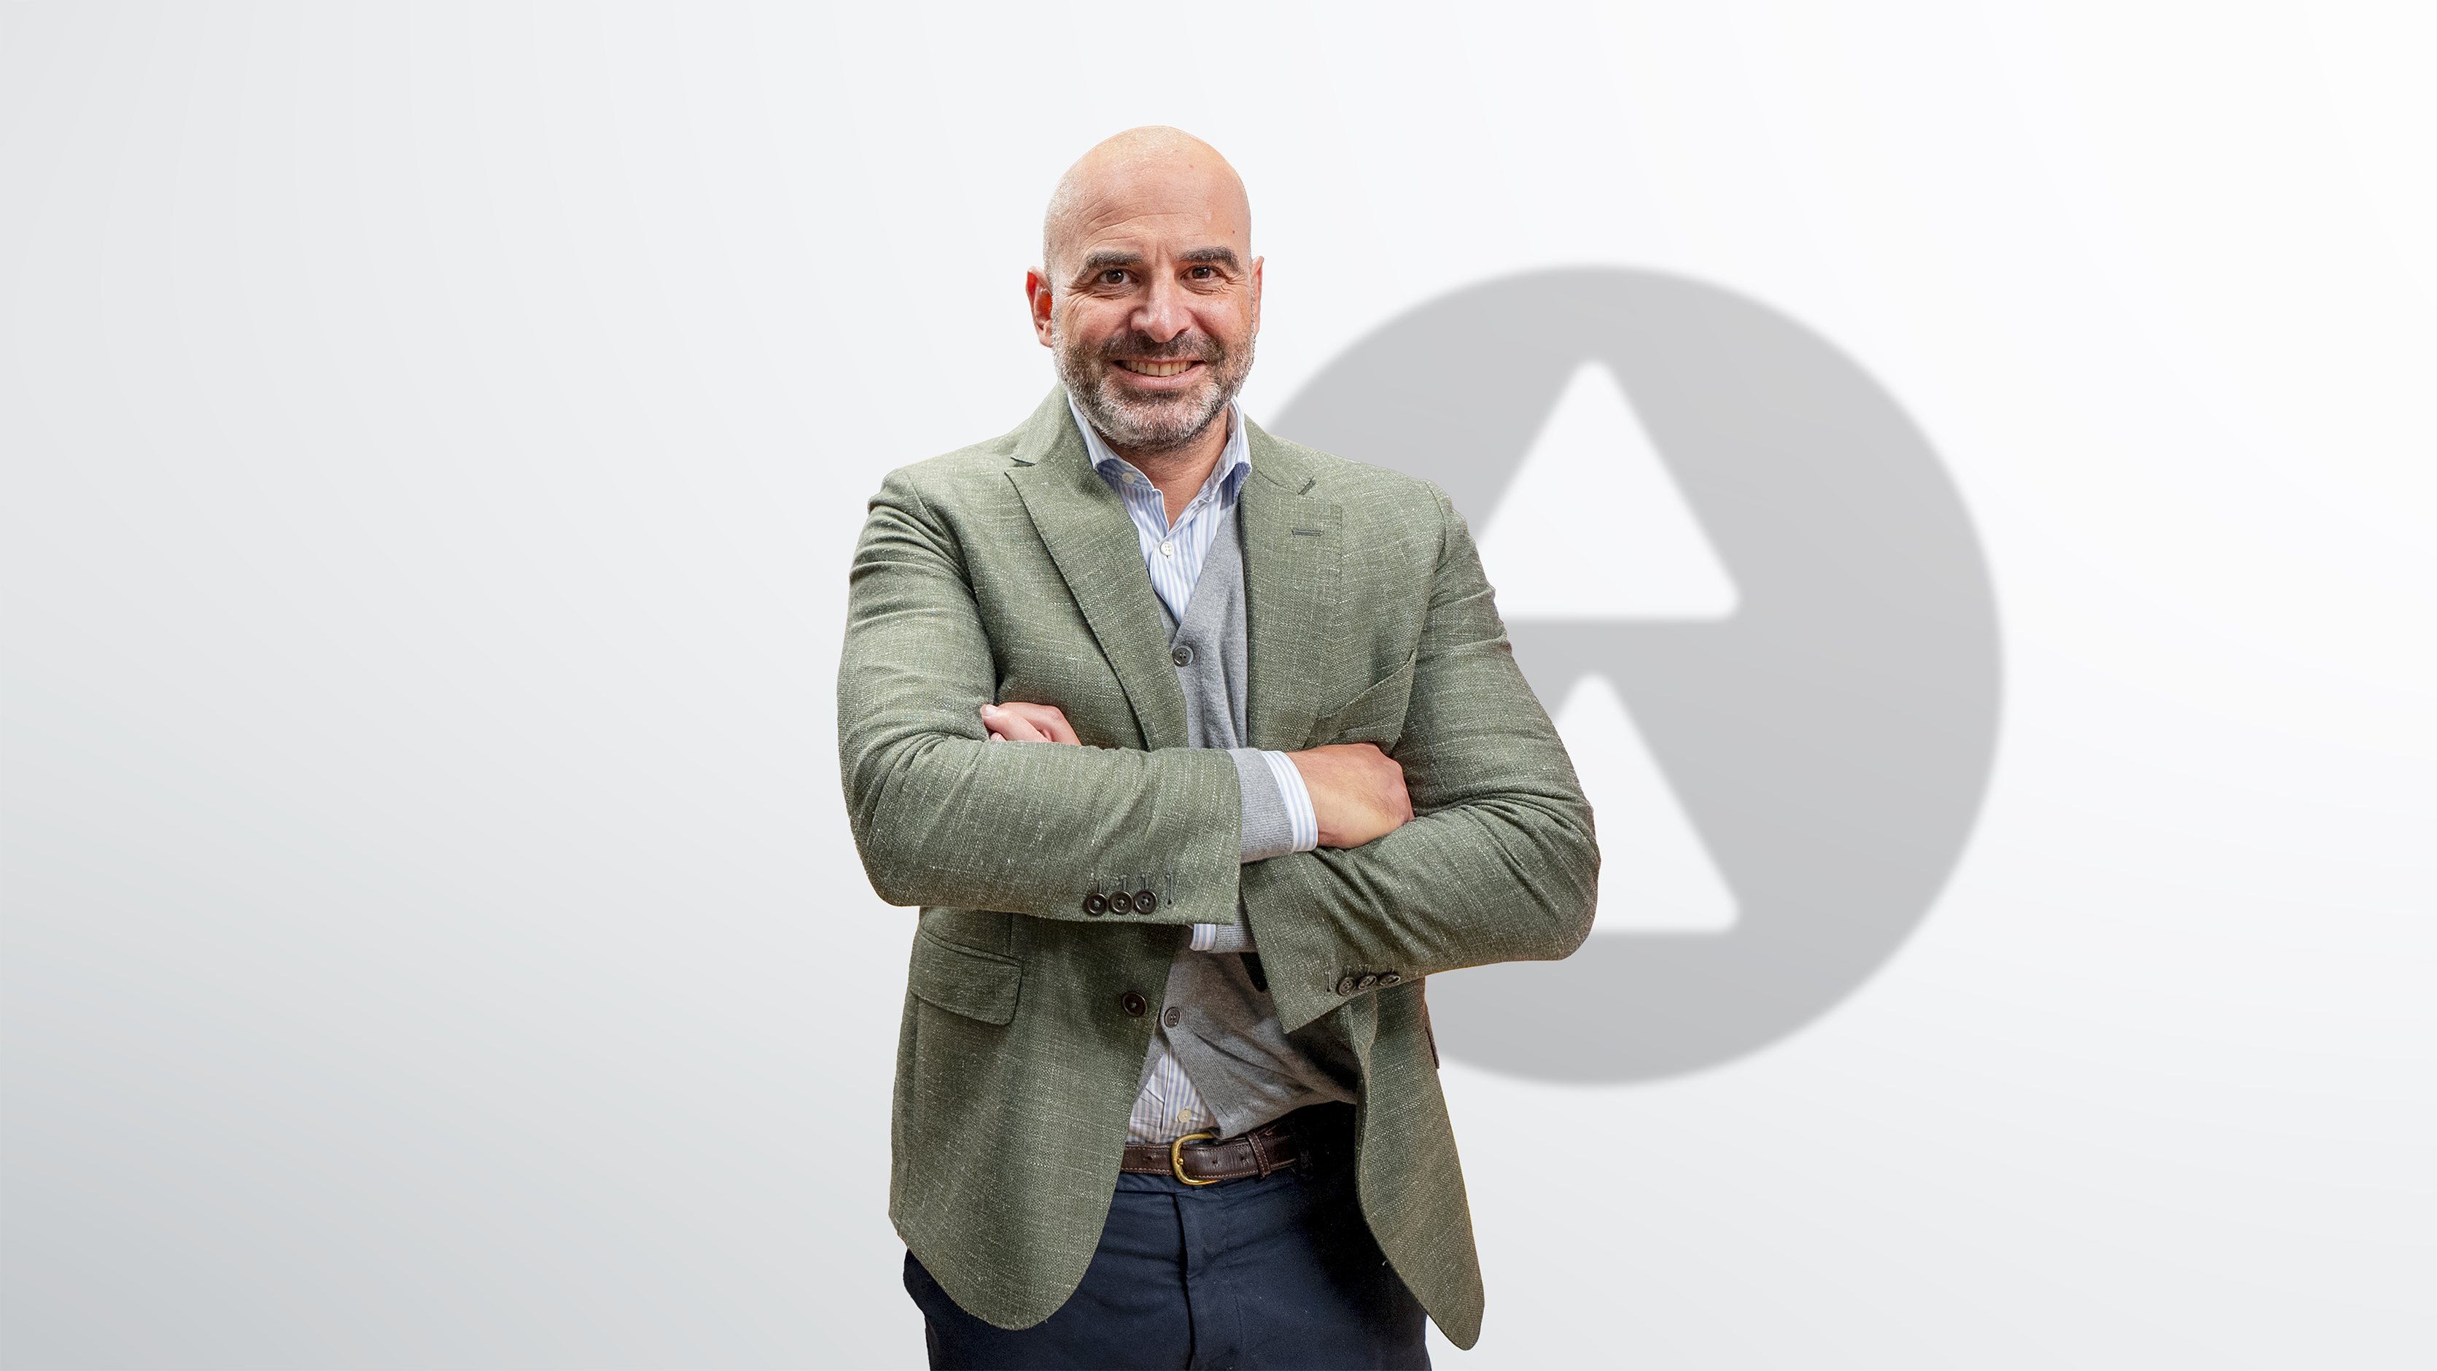
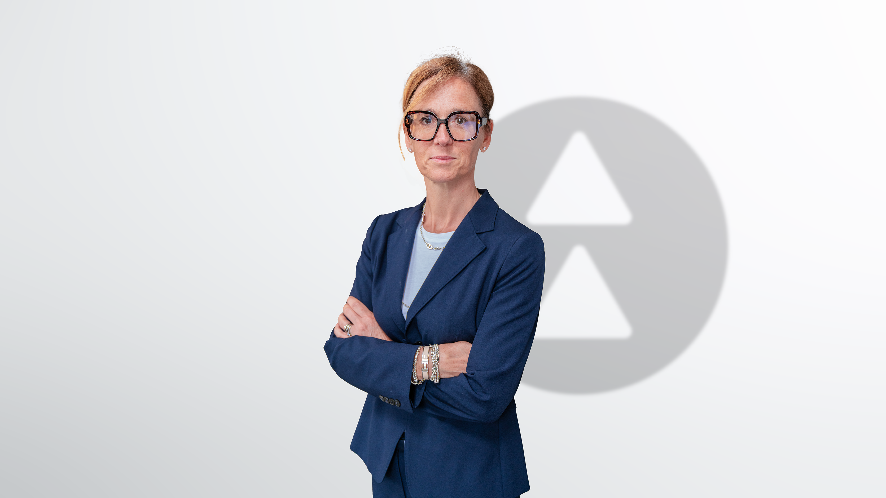
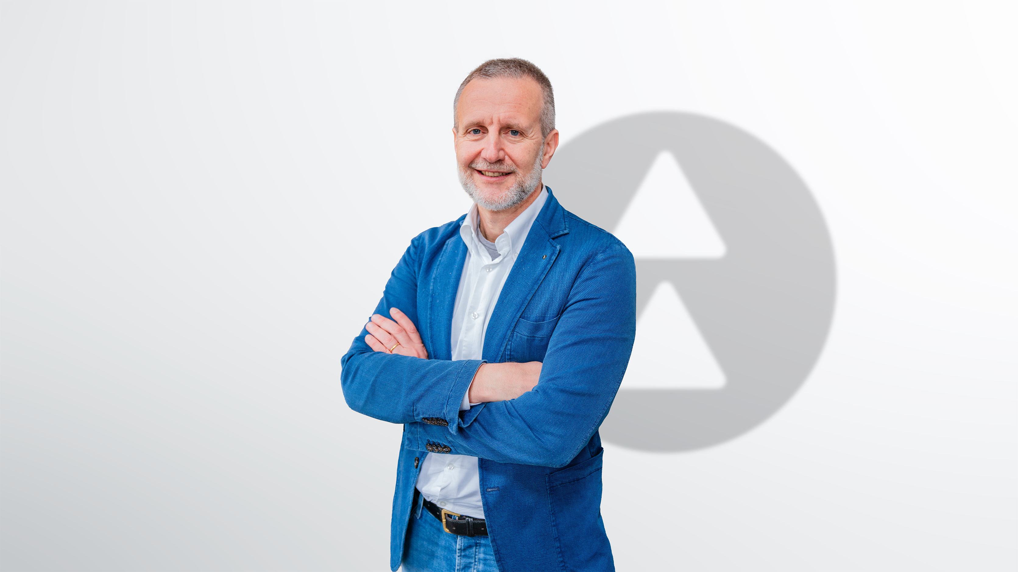
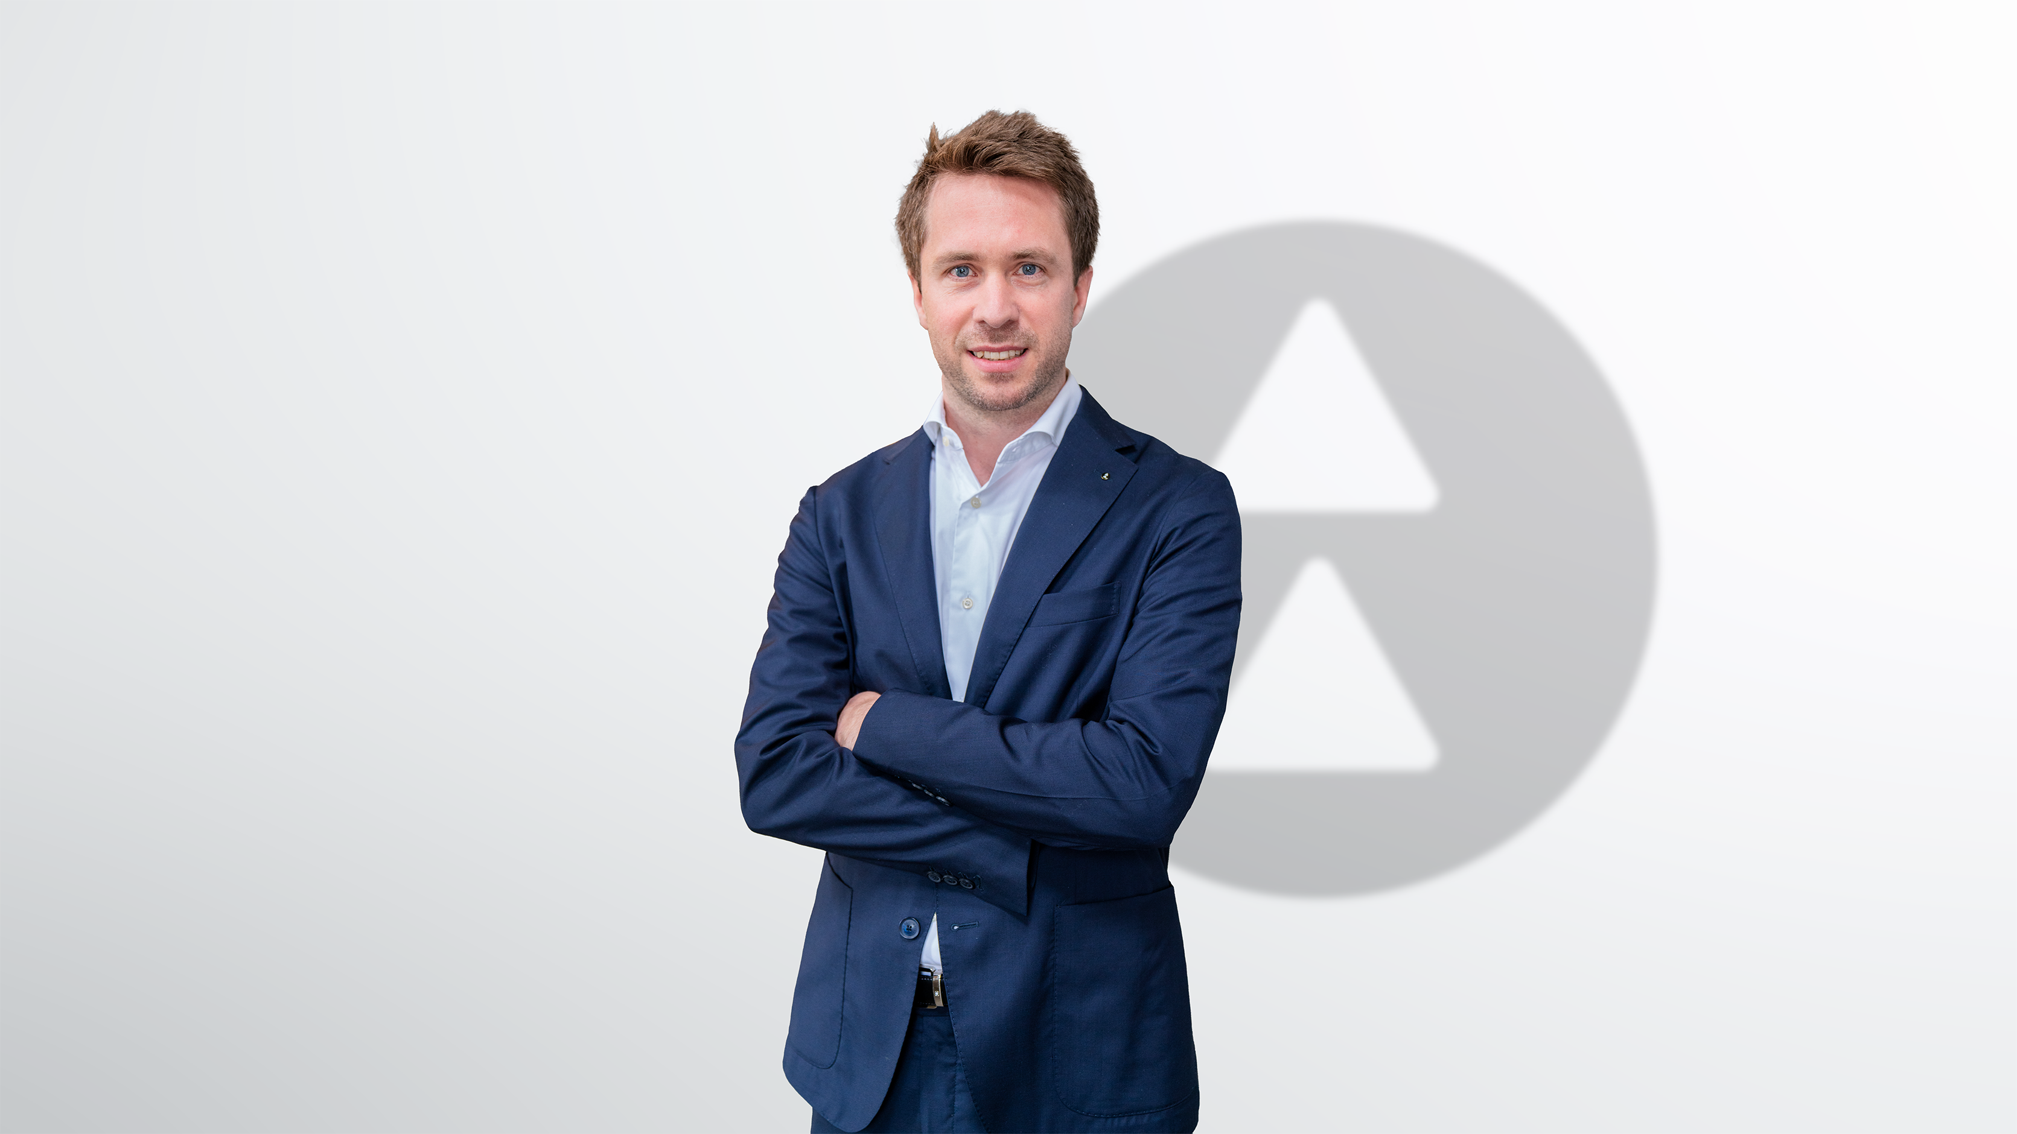
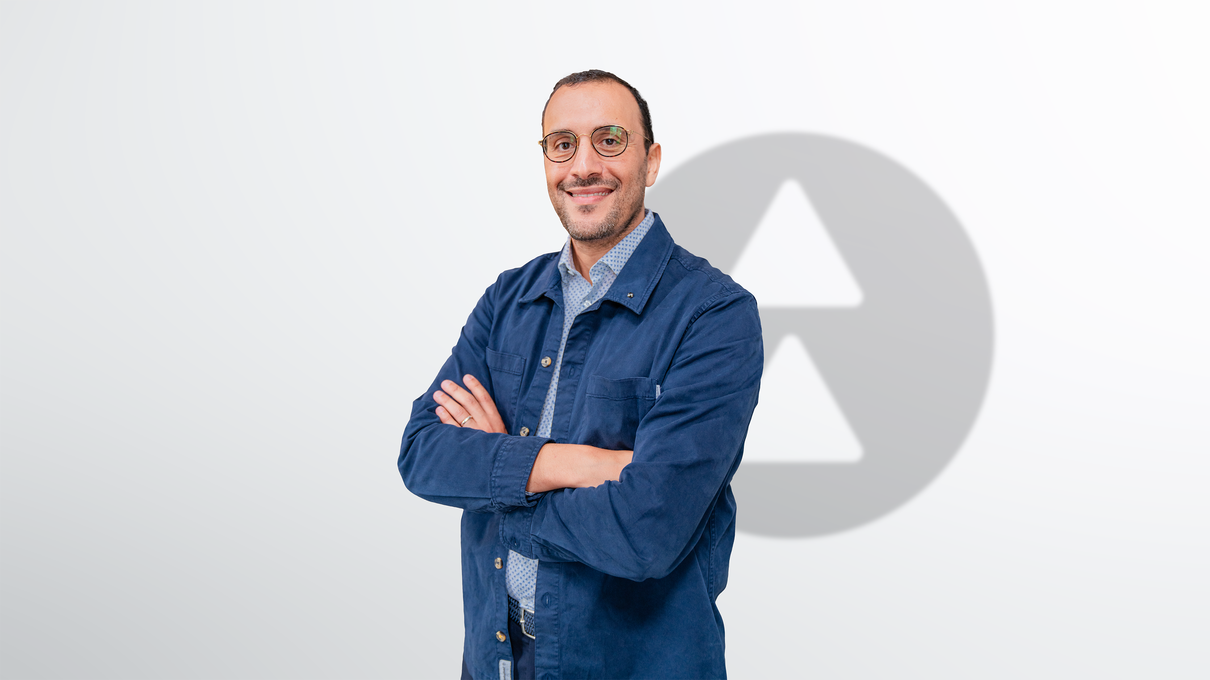
Executive Board
Andrea Galli
Group CEO
Edda Rettinger
Group CHRO
Davide Merlini
Group CTO/ CRO - North West Europe
Cristina Pagani-Boiani
CRO Central Europe
Andrea Polli
CRO Southern Europe
Roberto Schürch
CRO North America
Aymen Cheikh Mhamed
Group COO - Deputy CEO

Slide 17
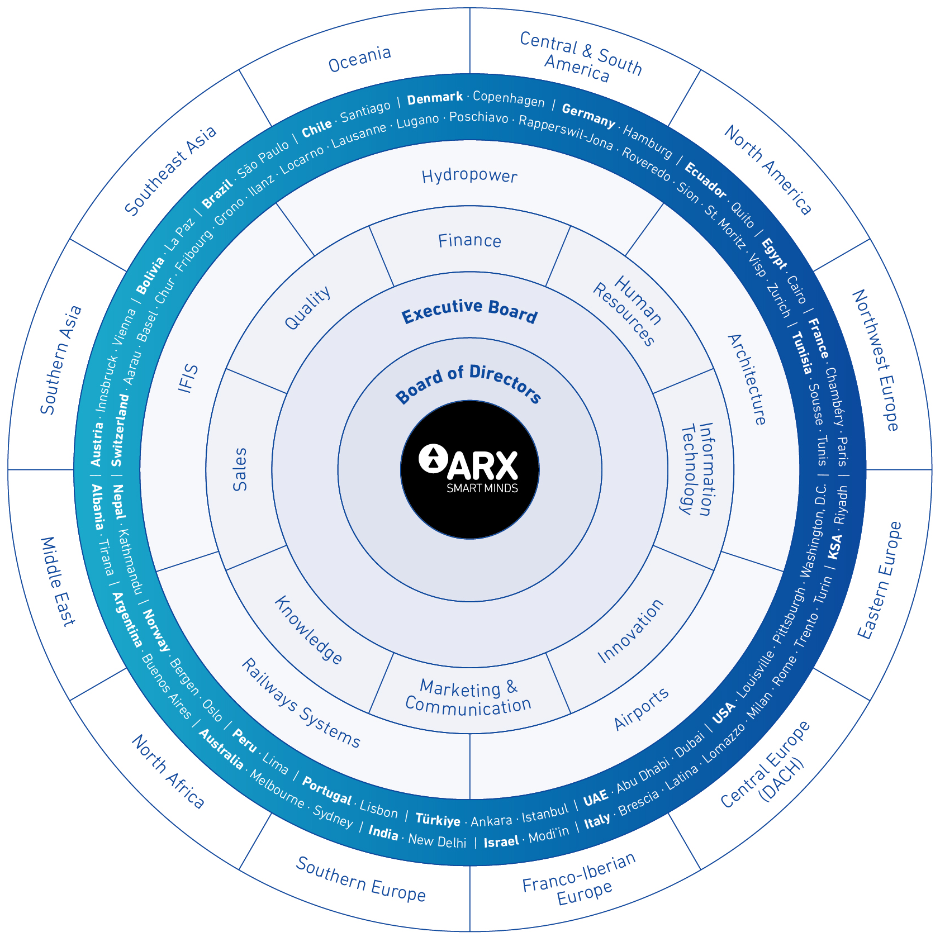

Slide 18
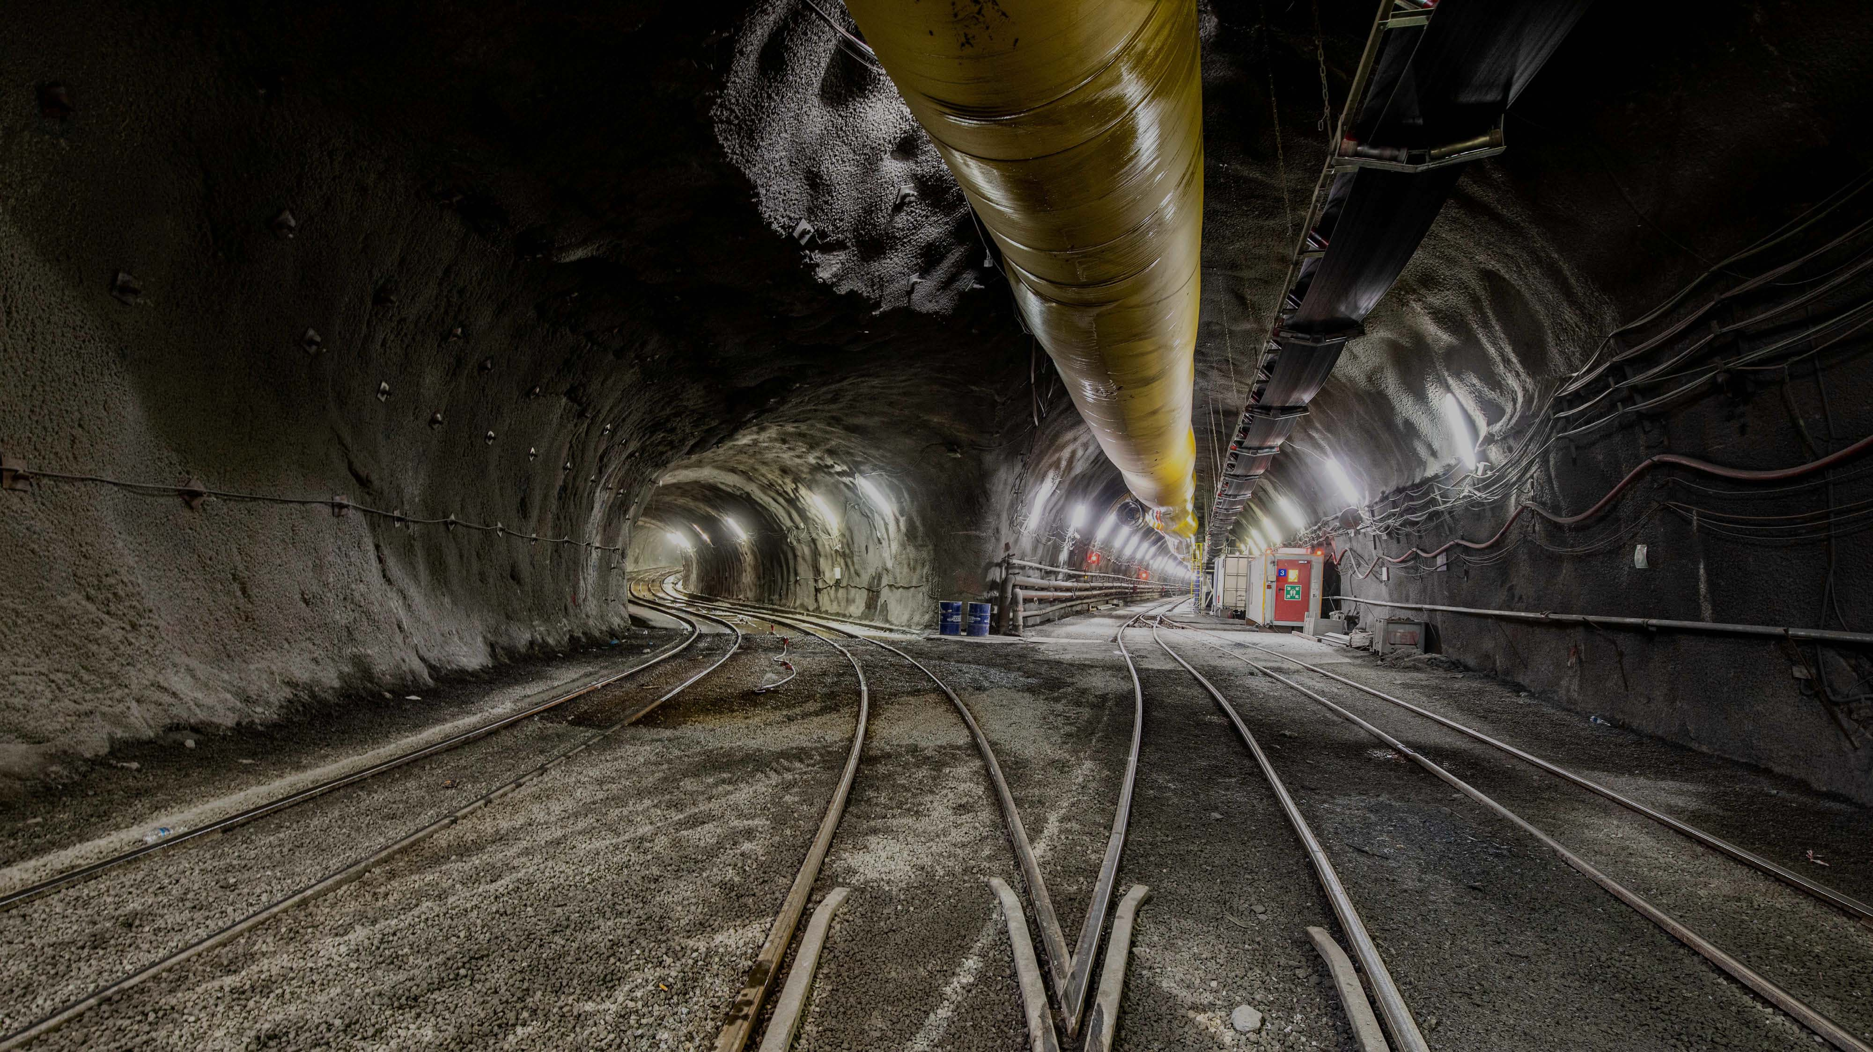
Brenner Base Tunnel
Austria-Italy
2014 – 2028
EUR 2’628’000’000
(Lots: H71, H61, H53, H52, H41, H33)
Infrastructure
Connecting people
through innovative systems
Some of the largest infrastructure projects
of our time comprise the core of our business. Using cost-efficient, sustainable solutions,
ARX has designed and constructed traffic routes at local, national, and international levels.

Slide 19
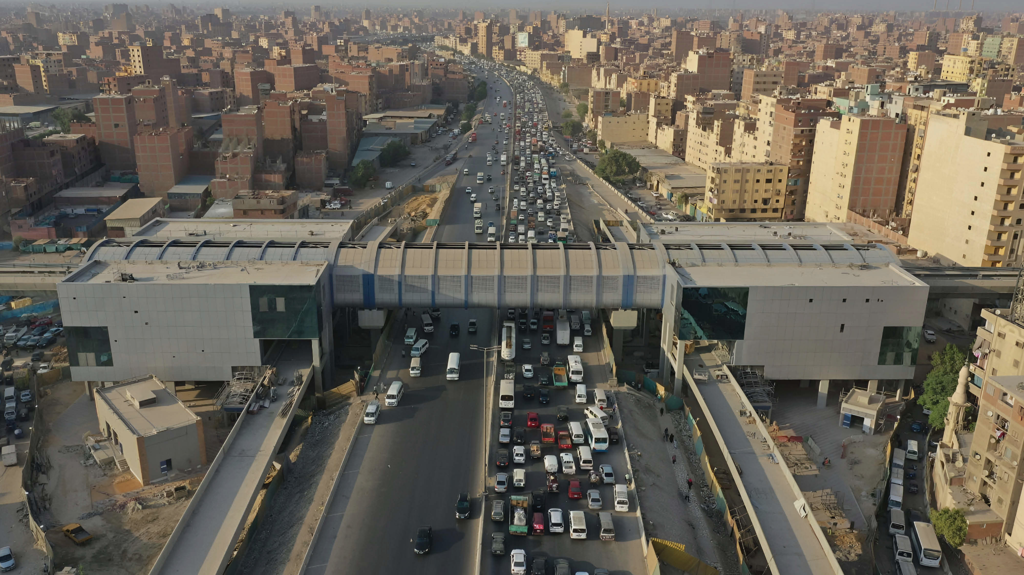
Cairo Metro L3
Phase 3
Egypt
2018-2023
USD 1’100’000’000
City
Shaping tomorrow’s cities
We help our clients reach new heights in rapidly changing modern cities, providing reliable partnerships with our architects. Using creativity and innovation, we deliver on challenging urban projects.

Slide 20
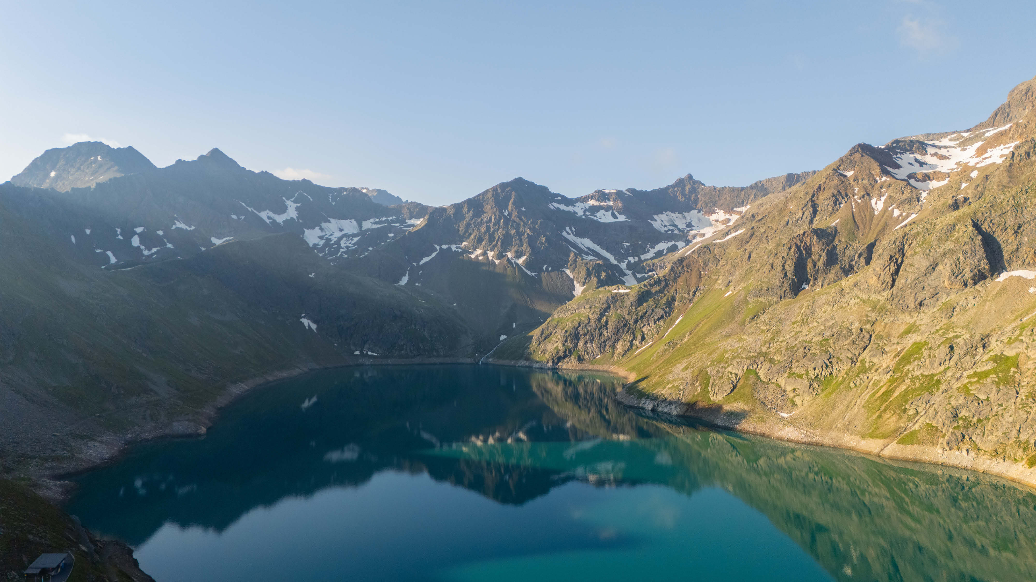
Kühtai PSPP
Austria
2021-2026
EUR 500’000’000
Energy
Creating paths to a sustainable future
From feasibility study to implementation, ARX is active in generating, distributing, storing, and consuming energy. In the increasingly complex energy sector, we are partners with our customers in seeking and analyzing solutions. Together we ensure their investments are sustainable and reliable long into the future.

Slide 21
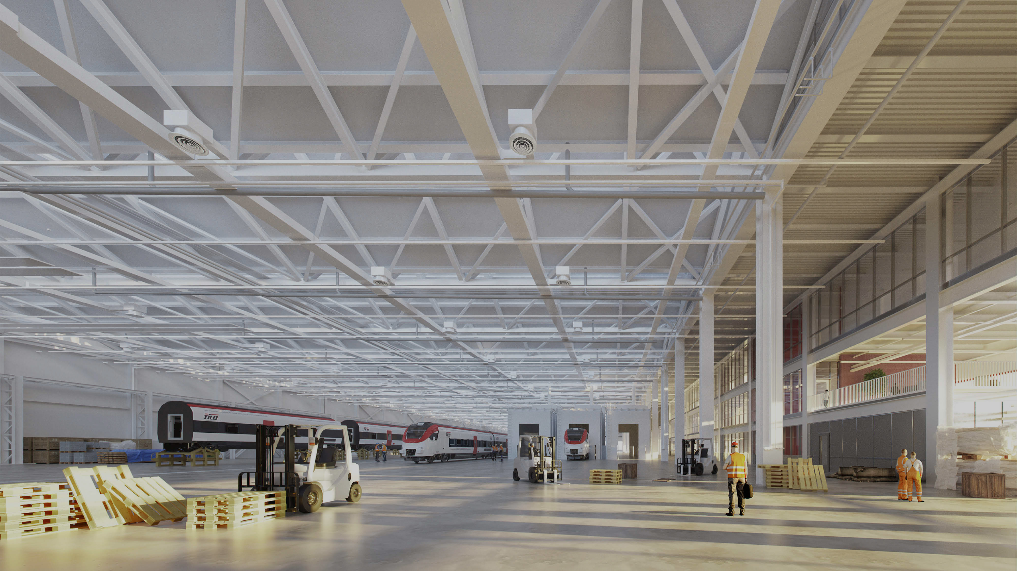
NSIF
Switzerland
2019-2027
CHF 755’000’000
Industry
Supporting industrial growth worldwide
The industrial world is evolving fast, with rising demands for quality, capacity, and cutting-edge tech. We’re here to help businesses stay ahead. From optimizing production and facility design to offering expert talent in mechanical and electrical engineering, we drive innovation and efficiency to meet the challenges of today
and tomorrow.

Slide 22
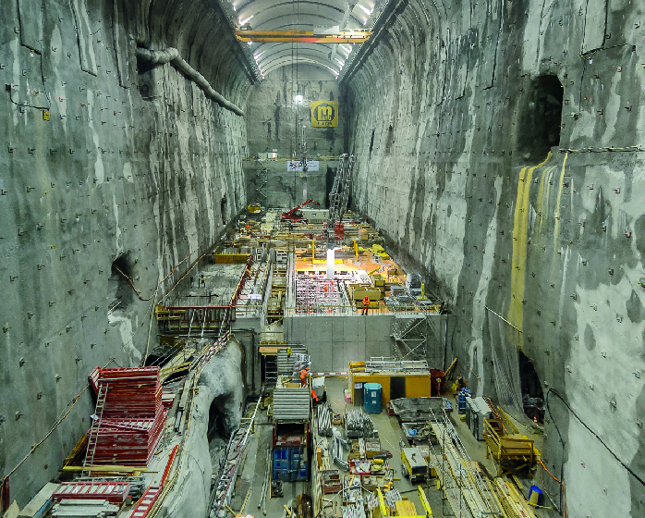
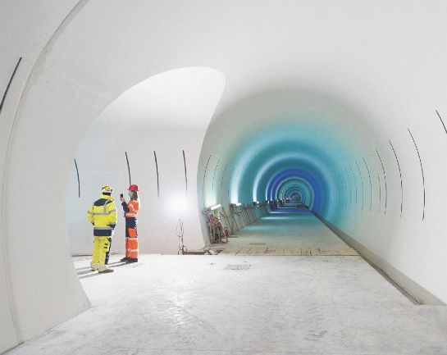
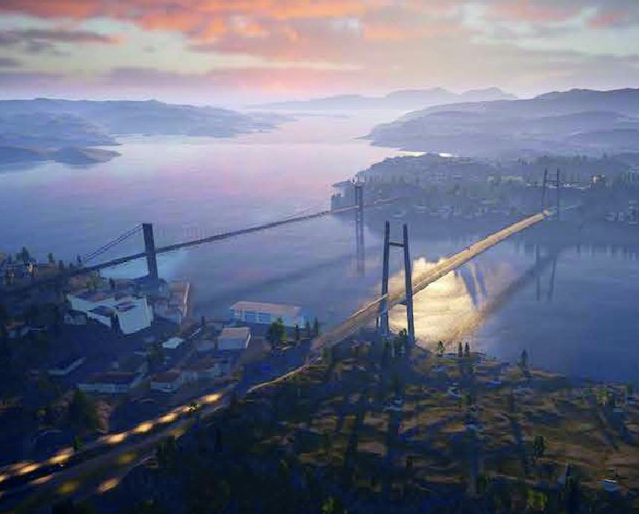
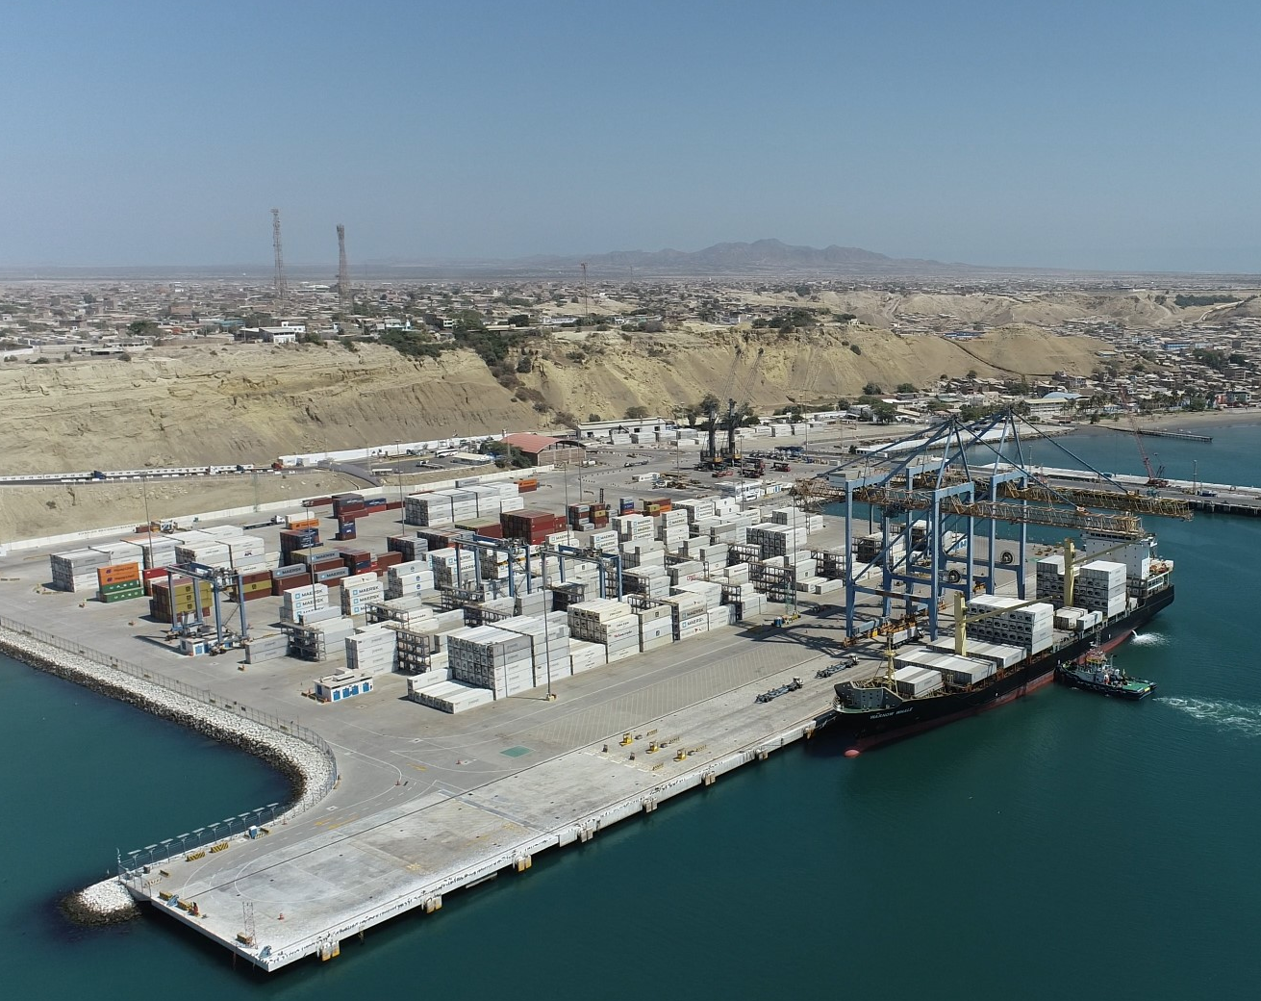
CompleXL
: a selection of our iconic projects
Linth-Limmern
Pumped Storage Power Plant
Country
Switzerland
Domain
Hydropower;
Tunnel & Underground
Client
AXPO AG
Time frame
2007-2019
Construction cost
CHF 1’800’000’000
CERN
High Luminosity Large Hadron Collider (HL-LHC), Point 5
Country
France
Domain
Buildings - civil engineering;
Tunnel & Underground
Client
CERN (European Organization for Nuclear Research)
Time frame
2016-2024
Construction cost
€ 65’000’000
Sotra Link
Country
Norway
Domain
Bridges & other Structures;
Roads; Tunnel & Underground;
Client
Sotra Link Construction JV
(Webuild, FCC Construction, SK E&C), Final Client: Statens Vegvesen (NPRA)
Time frame
2020-2027
Construction cost
€ 1’250’000’000
Port of Patia
Country
Perù
Domain
Ports / Maritime Works
Client
Etermar Engenharia e Construção SA
Time frame
2010-2011 (Phase 1) - new container berth with 300 m length
2020-2021 (Phase 2) - container berth extension with 60 m length
2020-2022 (Phase 3) - new terminal berth with 364 m length
Construction cost
USD 131’000’000 (Phase 1)
USD 19’300’000 (Phase 2)
USD 19’800’000 (Phase 3)

Slide 23
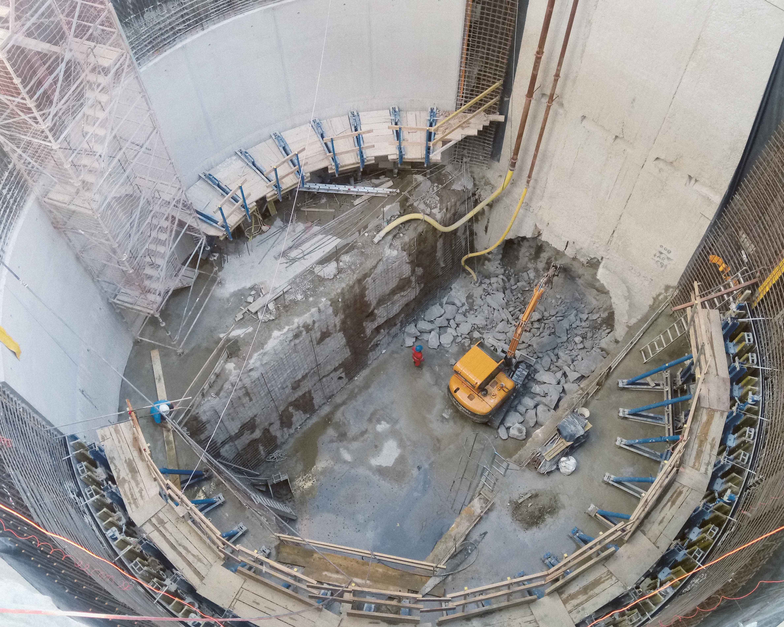
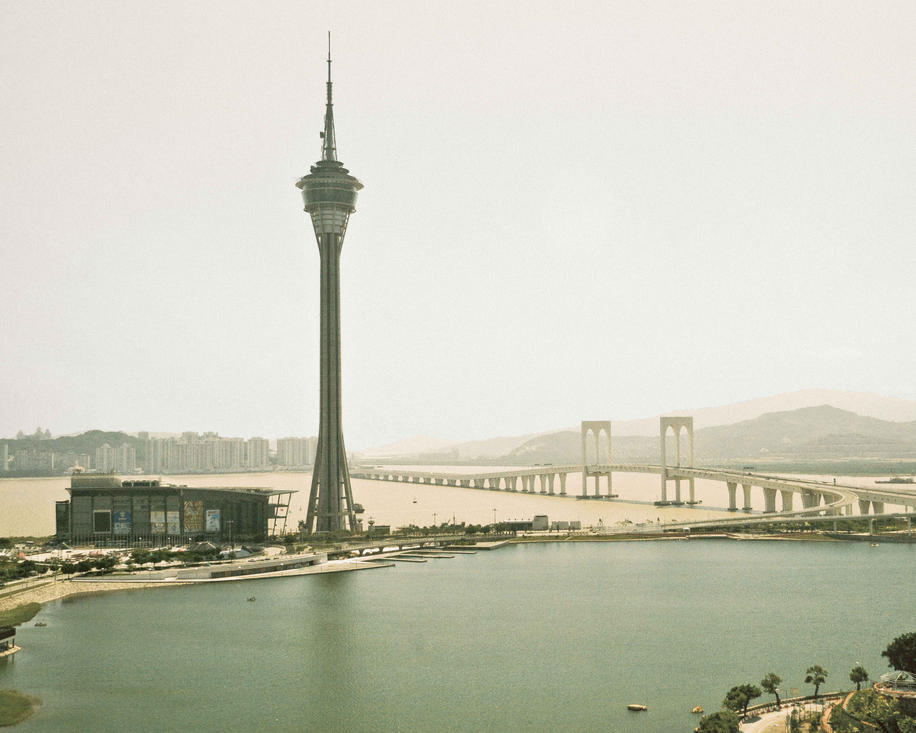
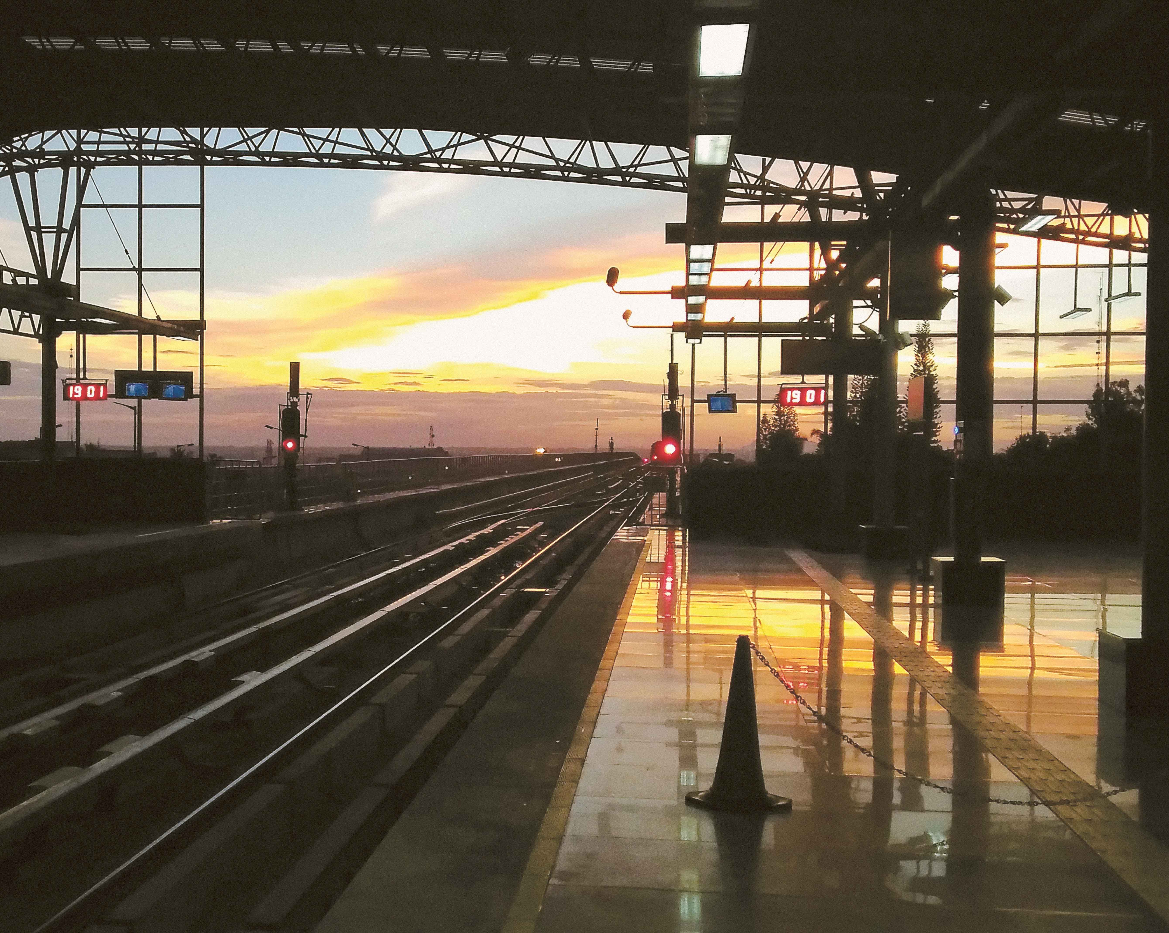
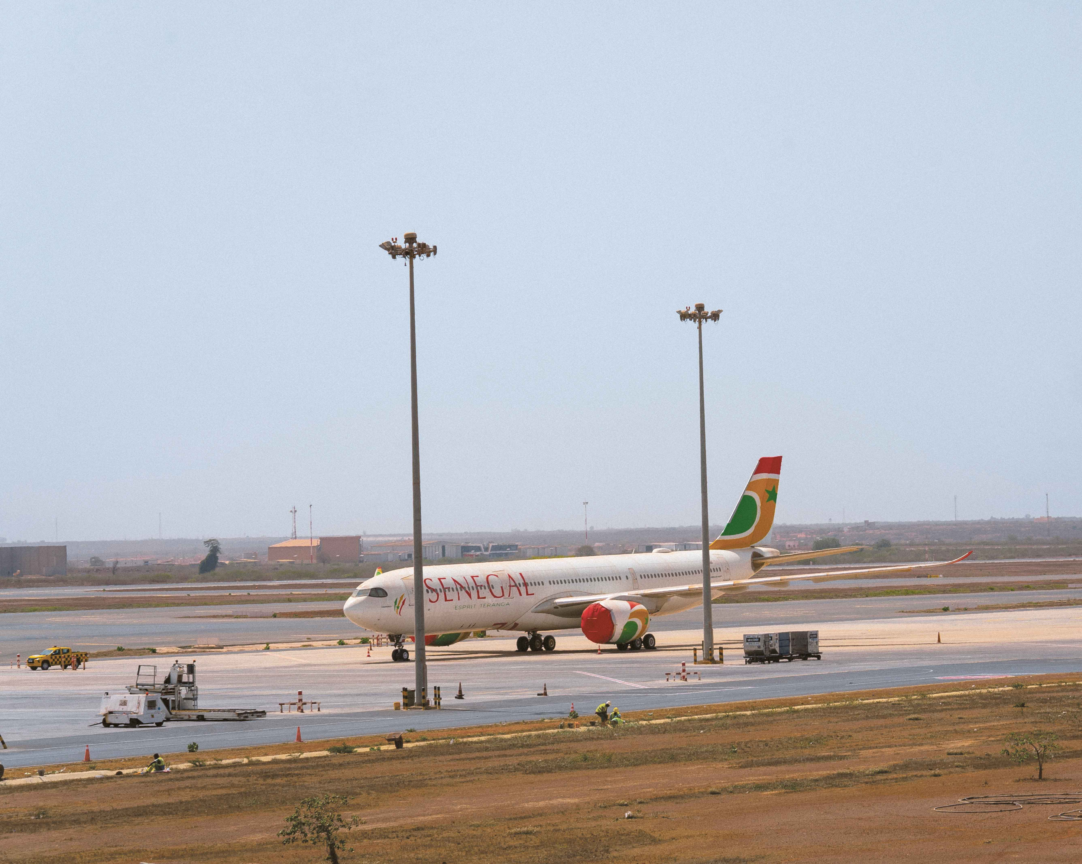
CompleXL
: a selection of our iconic projects
Riachuelo Sewage System
Country
Argentina
Domain
River engineering;
Water / Wastewater treatment
Client
Agua y Saneamientos Argentinos S.A.
Time frame
2014-2021 (Lot 1)
2014-2022 (Lot 3)
Construction cost
USD 320’000’000 (Lot 1)
USD 434’000’000 (Lot 3)
Friendship Bridge
over the South China Sea
Country
China
Domain
Bridges & other Structures
Client
Government of Macau
Time frame
1994
Construction cost
USD 55’000’000
Metro
of Bangalore
Country
India
Domain
Metros
Client
Eiffage Sénégal
Final client: AIBD
Time frame
2022-2024
Construction cost
USD 15’500’000
MRO & Cargo infrastructures
Airport Blaise Diagne
Country
Senegal
Domain
Airports
Client
Eiffage Sénégal
Final client: AIBD
Time frame
2022-2024
Construction cost
USD 15’500’000

Slide 24
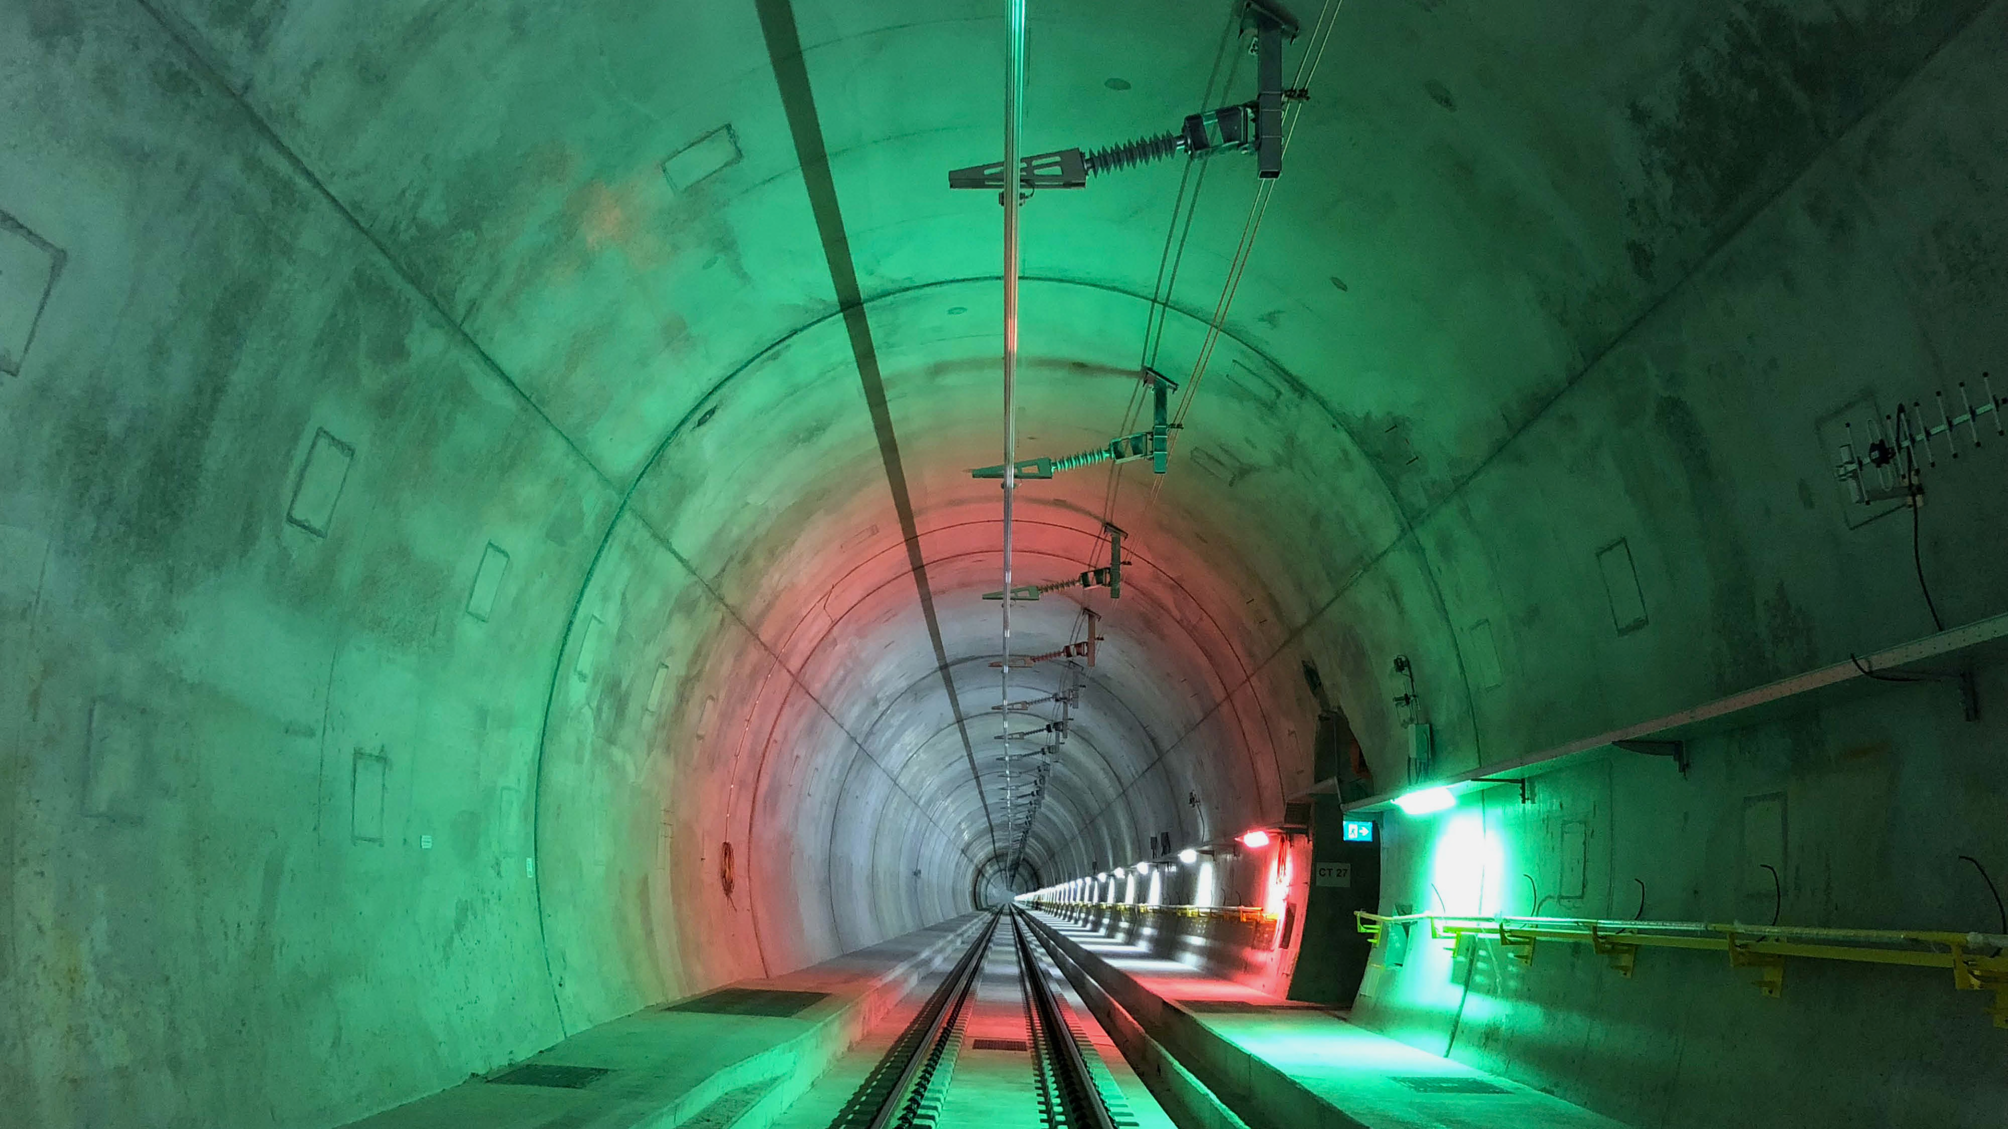
CompleXL
We aim to become the preferred choice whenever complex
projects that require our input and value generation are in play.
When innovation needs to take tangible form, we can conjure
unconventional ideas and take on audacious challenges with
the right expertise.

Slide 25
CompleXL
We aim to become the preferred choice whenever complex
projects that require our input and value generation are in play.
When innovation needs to take tangible form, we can conjure
unconventional ideas and take on audacious challenges with
the right expertise.

Slide 26


Make
it
happen
Thank you

